Slide 1
Developing project learning skills
Writing the learning journal – My 3-2-1 Record
Reading strategy: previewing the text
Taking notes using graphic organisers

Slide 2
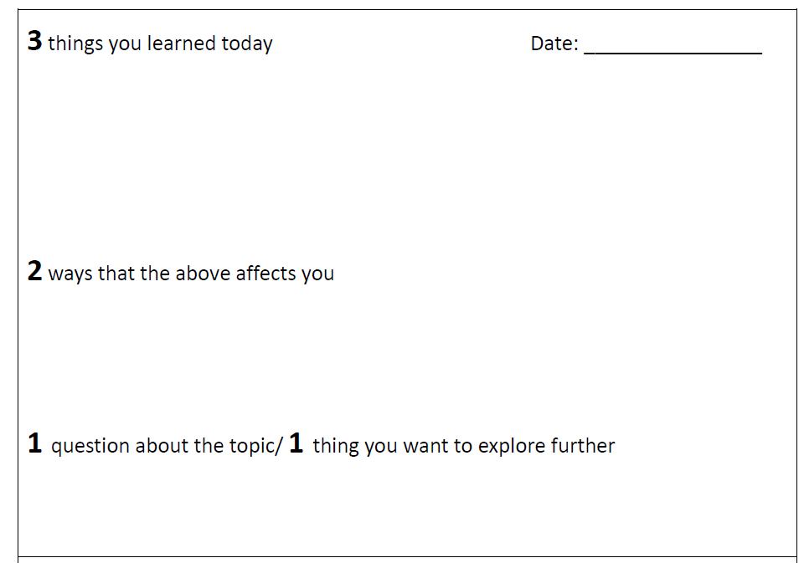
Writing the learning journal – My 3-2-1 Record
It helps you to think about what you know, what you do not know and what you want to know. Then you can plan what to do next.
My 3-2-1 Record

Slide 3
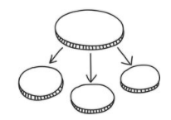
My 3-2-1 Record
Write at least 3 things you learned today.
Project learning
spend a lot of time on research
self-management skills
think critically and make reflection
Notes:
Ilicit answers from students. E.g.

Slide 4
Structure your answer:
My 3-2-1 Record
Write at least 3 things you learned today.
Today I have heard something about______________. I have learnt some interesting facts about it.
Topic sentence
project learning
project learning means spending a lot of time on research
Linking words –
list points
To begin with, ________________________________ . Secondly, _____________________________________. What’s more, _________________________________. To sum up, ___________________________________.
I will learn to think critically and make reflection.
Linking words – add more points
I will learn self-management skills.
I will be learning many things I do not know before.
Linking words – to conclude

Slide 5
Elaborate your points with examples and explanations
Today I have heard something about project learning. I have learnt some interesting facts about it. To begin with, project learning means spending a lot of time on research. For example, I need to search for information about an environmental issue and write a report. Secondly, I will learn to think critically and reflect. This means that I need to think and question findings in more detail. What’s more, I will learn self-management skills. In other words, I will learn skills that help me work efficiently. To sum up, I will be building skills that I lack. This really sounds interesting! I am looking forward to it! Can’t wait!

Slide 6
My 3-2-1 Record
Think of 2 ways that the above affects you.
This helps you think about the impact the information has on you.
Does it change what I think or know about the topic?
How do you feel? Why?
How does this learning relate to your life?
How can you apply what you learn in your life?
How can you help/improve the situation?
Are you doing right/well?
Is this information useful/important to know?
This helps you connect what you know with your life to make the information meaningful to you.
This helps you think creatively.
This helps you reflect on your current practice.
This helps you think critically.

Slide 7
My 3-2-1 Record
Think of 2 ways that the above affects you.
I feel like a university student for I am about to do research like what a university student always needs to do. I am a bit worried though as I am not sure if I can manage.
feelings
reasons

Slide 8
My 3-2-1 Record
Think of 2 ways that the above affects you.
I feel like a university student for I am about to do research like what a university student always needs to do. I am a bit worried though as I am not sure if I can manage. What I know is that these skills will help me to succeed in the future! That sounds important and useful to me.
can manage.
This helps you connect what you know to your life to make the information meaningful to you.

Slide 9
My 3-2-1 Record
Ask 1 question about the topic.
OR
Find 1 thing you want to explore further.
How can I know more about project learning? I am going to google it and ask my sister to tell me more.

Slide 10
Previewing is a reading strategy.
It helps readers to:
recall prior knowledge
set a purpose for reading
understand how the author has organised the information
In Project Learning
When do you need to preview a text?
Why do you need to preview a text?
How often do you preview a text?

Slide 11
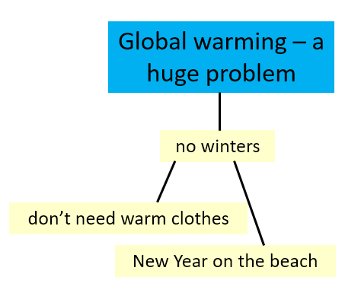
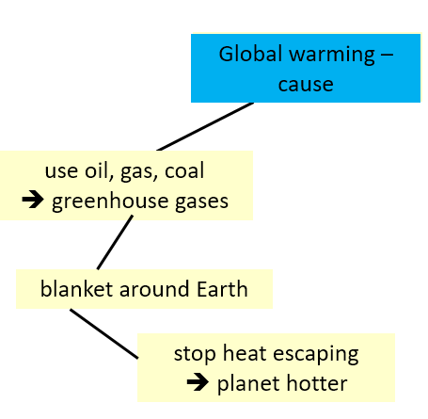
The structure of the passage
Taking notes while reading (using graphic organisers)
Solution
Effect
Cause

Slide 12
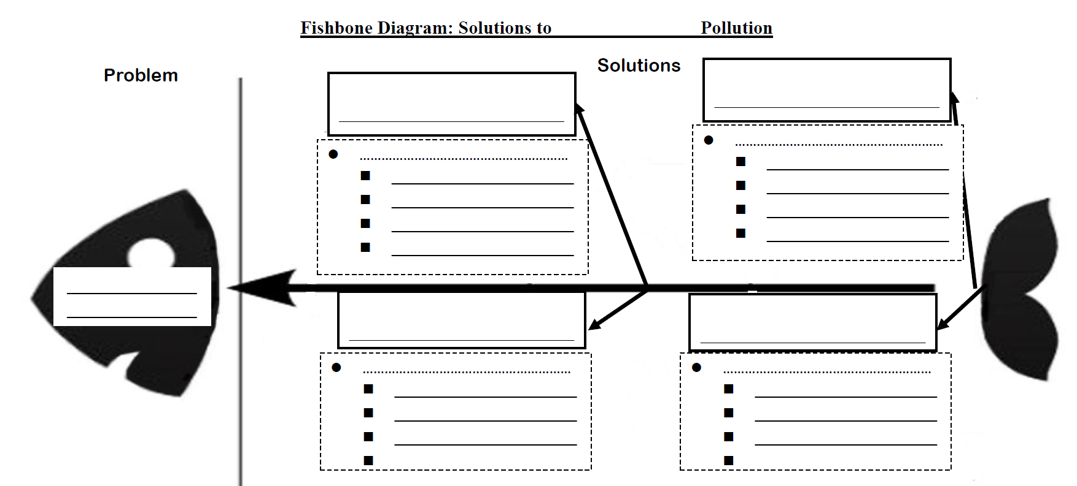
Using different mind maps to organise the notes
Fishbone Diagram for solutions to a problem
Useful for organising notes about different solutions to a problem

Slide 13
Enriching the chart with notes from different sources
Solution
You can add more notes to this Problem Solution Chart.

Slide 14
Reduce carbon footprint - reduce
Reduce car journeys – walk
Reduce carbon footprint - reuse
Reduce carbon footprint - recycle
Donate old clothes and toys
to charity shops
Recycle bottles and cans

Slide 15
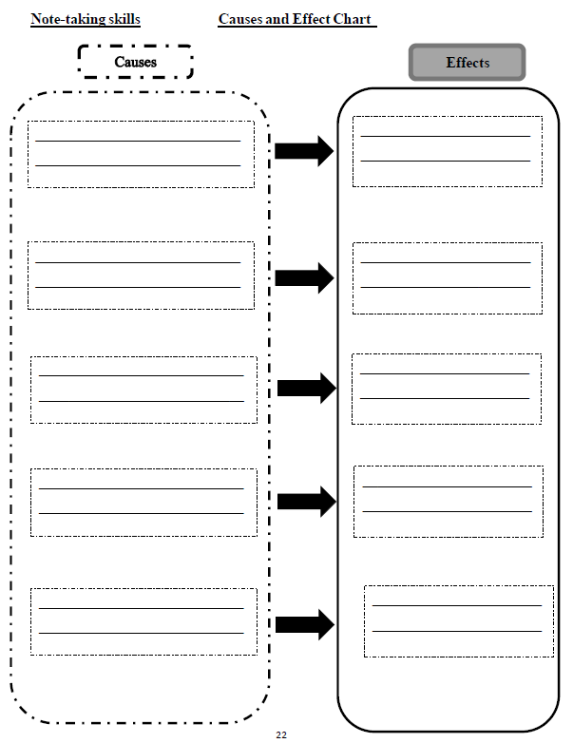
Using different mind maps to organise the notes
Cause and Effect Chart
Useful for organising information about cause and effect

Slide 16
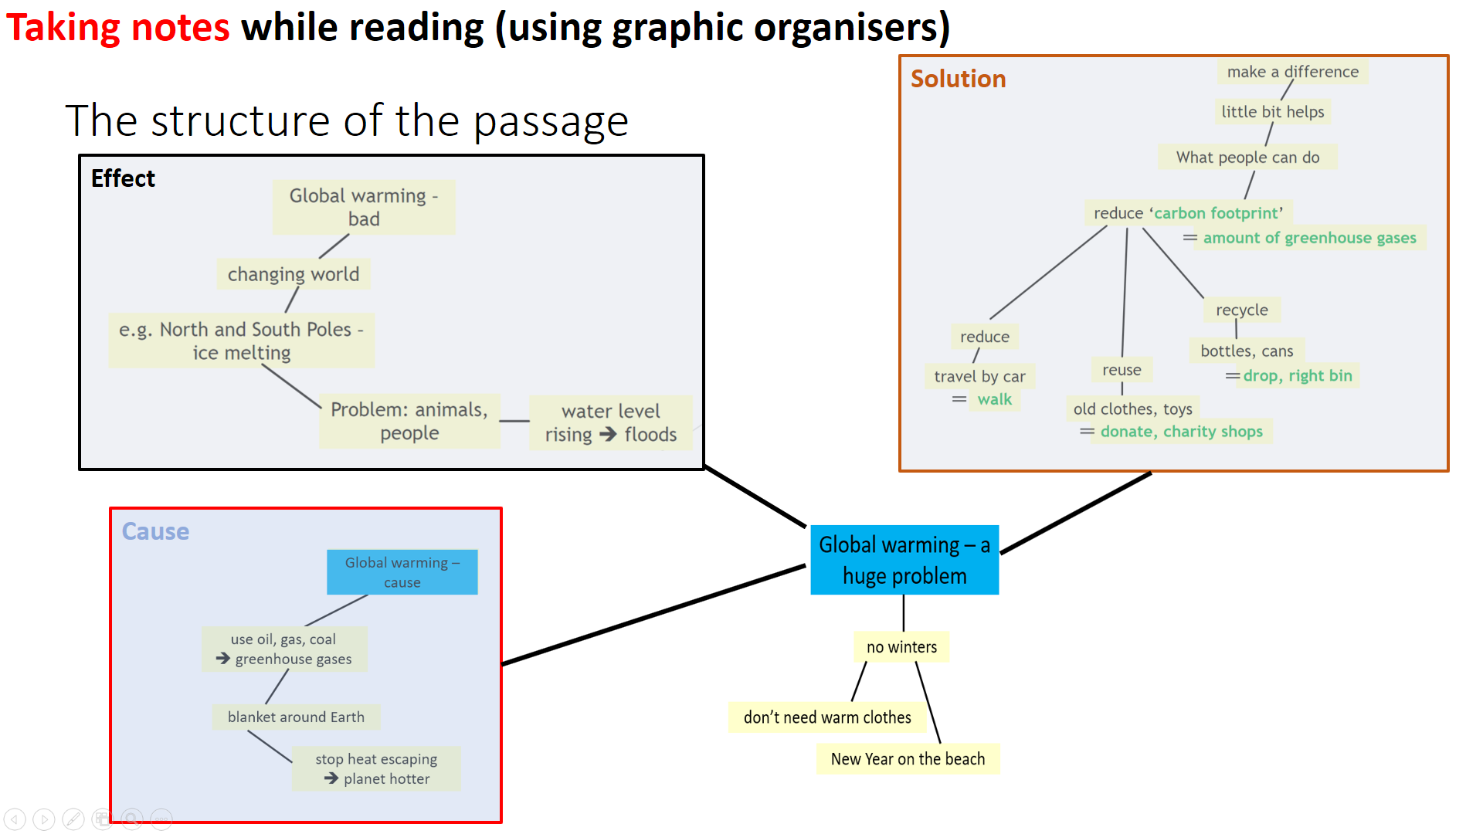
Using different mind maps to organise the notes
Cause and Effect Chart
People use oil, gas and coal.
Greenhouse gases are produced.
Greenhouse gases make Earth hotter.
Ice is melting at the North and South Poles.
Melting ice raises the water level.
floods

Slide 17
Does the passage explain the topic clearly? Is there anything not clear?
People use oil, gas and coal
Greenhouse gases are produced
Greenhouse gases make Earth hotter
Ice melting at the North and South Poles
Melting ice raises the water level.
floods
What is “oil, gas and coal”? Do I use them as well?
Read other materials to find out!

