Slide 1
Developing generic skills
Time management skills
Problem solving skills

Slide 2
Time management skills
Step 1: Create a To-Do list
Speed Writing for 1 minute
What do you need to do? Today?
In these few days? In these few weeks?
Do my homework
Write a mini report (Project Learning)
Prepare my written report (Project Learning)
Practise the piano
Read a book
Finish art work
Tidy up my desk

Slide 3
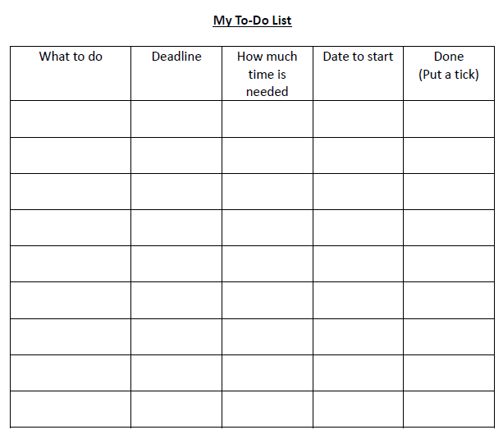
Step 1: Create a To-Do list
Put them in the To-Do List
Fill in details
Do my homework
tomorrow
1.5 hours
today
Finish art work
19/4
3 hours
16/4
Practise the piano
Read a book
Tidy up my desk
Prepare a written report (Project Learning)
Write a mini report
(Project Learning)

Slide 4
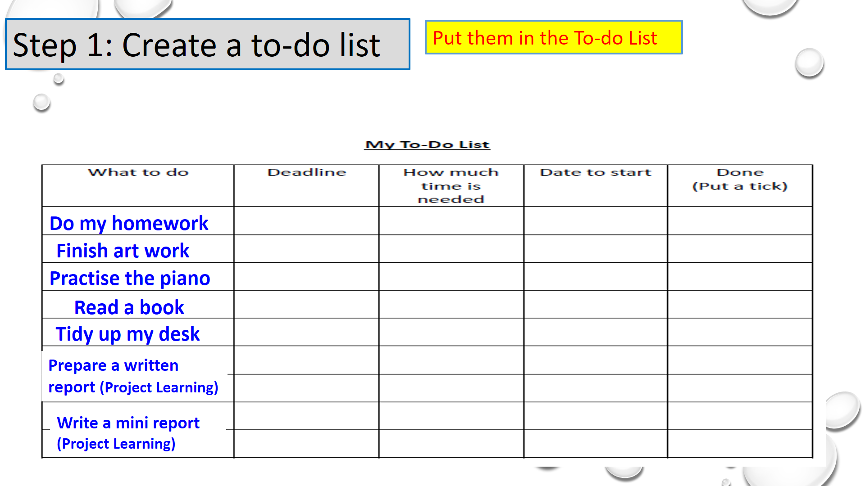
Step 2: Select tasks that are difficult
Difficult

Slide 5
Step 3: Break down a difficult task into small steps
Wait! It’s important to set goals before planning the steps!
Setting goals for the project
Finish WS 1 Part E Setting Goals

Slide 6
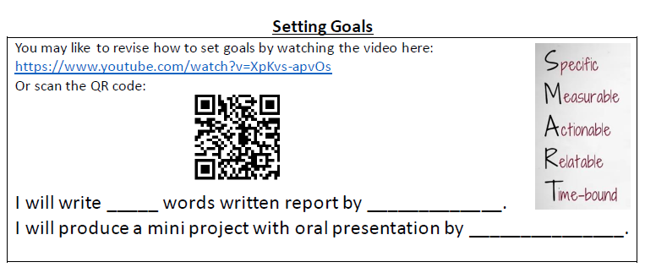
No. of words
Deadlines

Slide 7
Step 3: Break down a difficult task into small steps
Written report (Project Learning)
Brainstorm the steps for writing the report
Speed Writing for 1 minute
Design a cover
Write a draft
Select a topic
Proofread the final report
Revise the draft
Collect ideas for the report
Print the report
Prepare a mind map for the report
Collect information about the topic
Take notes and organise information

Slide 8
Step 3: Break down a difficult task into small steps
Written report (Project Learning)
Put the steps in sequence
Design a cover
Proofread the final report
Collect ideas for the report
Select a topic
Prepare a mind map for the report
Revise the draft
Print the report
Write a draft
Collect information about the topic
Take notes and organise information

Slide 9
Step 4: Set priorities for the tasks
Spare enough time and effort to finish the tasks on the top of the list.
Do my homework
3
Finish art work
5
Practise the piano
4
Read a book
7
Tidy up my desk
6
Prepare a written report (Project Learning)
1
Write a mini report
(Project Learning)
2

Slide 10
Step 5: Estimate the time needed for each task
Do my homework
1.5 hours
Finish art work
3 hours
Practise the piano
45 minutes
Read a book
15 minutes
Tidy up my desk
10 minutes
Prepare a written report (Project Learning)
3 weeks
Write a mini report
(Project Learning)
3 weeks

Slide 11
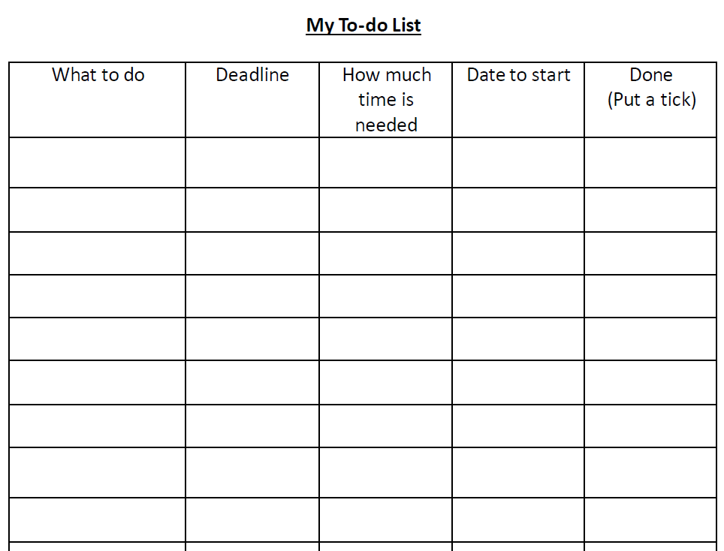
Step 5: Estimate the time needed for each task
Let’s practise together
When is the best time to finish the task?
Calculate when you should start to work.
Written report (Project Learning)
Select a topic
13/4
1 day
Today
Plan the time you need for each task.
30/4
15 days
15/4
Collect information about the topic
Take notes and organise info
30/4
15 days
15/4
Collect ideas for the report
1/5
30 minutes
1/5
Prepare a mind map for the report
1/5
30 minutes
1/5
Write a draft
2/5
3 hours
1/5
Revise the draft
3/5
2 hours
2/5
Proofread the final report
3/5
1 hour
2/5
Design a cover
3/5
3 hours
2/5
Print the report
3/5
1 hour
3/5

Slide 12
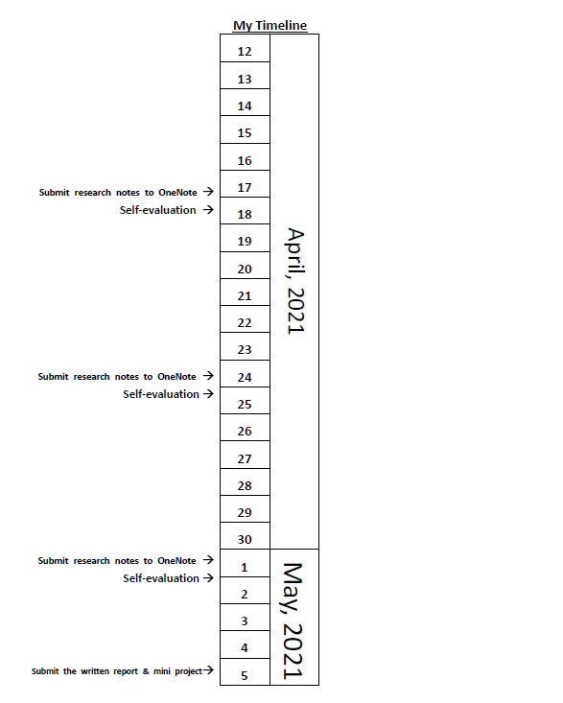
Use a timeline to help you plan the tasks
Select a topic
Take notes and organise the information
Collect information about the topic
Collect ideas for the report
Write a draft
Proofread the final report
Design a cover
Print the report
Revise the draft

Slide 13
Step 6: Calculate the total amount of time needed
3
tomorrow
1.5 hours
today
Do my homework
Total time needed:
2 hours and 55 minutes
Finish art work
5
19/4
3 hours
16/4
Practise the piano
4
45 minutes
today
Read a book
1
30 minutes
today
Tidy up my desk
7
10 minutes
today
Prepare a written report (Project Learning)
3 weeks
1
Write a mini report
(Project Learning)
2
3 weeks

Slide 14
Step 7: Tick the completed tasks
Do my homework
3
tomorrow
1.5 hours
today
Finish art work
5
19/4
3 hours
16/4
Practise the piano
4
45 minutes
today
Read a book
1
30 minutes
today
Tidy up my desk
7
10 minutes
today
Prepare a written report (Project Learning)
1
3 weeks
Write a mini report
(Project Learning)
3 weeks
2

Slide 15
Problem solving skills
The problem solving sequence
The Problem:
The passage is difficult to understand.
I look up the meaning of every word.
Define the problem
Step 1: Define the problem
Brainstorm solutions
The passage is for adult readers.
Which one is the real cause of the problem?
Choose a solution
I did not use reading skills.
I spent so much time looking up meanings of words.
Test the solution
I do not know many words.
Review the results

Slide 16
Problem solving skills
Step 1: Define the problem
The real cause of the problem
The passage is for adult readers.
Chose the wrong thing. . .
I did not use reading skills.
Poor Skills
I spent so much time looking up the meaning of words.
Didn’t know how to get main ideas.
+ Weak vocabulary
I do not know many words.
Weak vocabulary

Slide 17
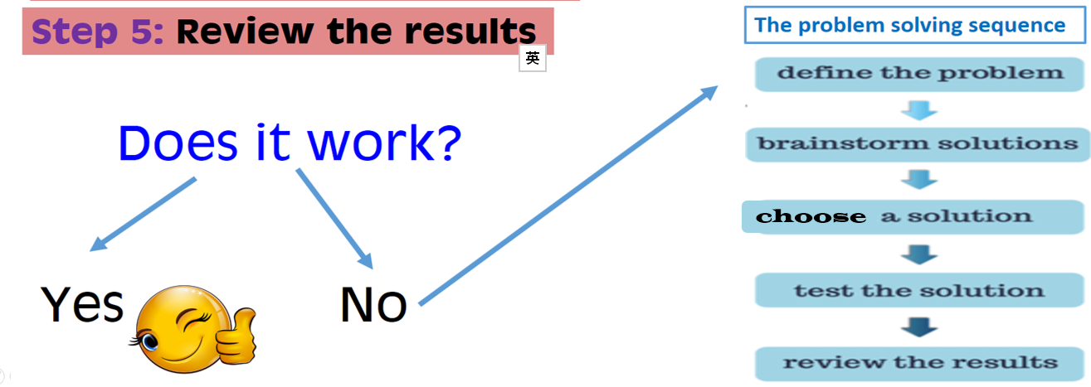
Problem solving skills
Step 2: Brainstorm solutions
Choose the best Solution
+ Weak vocabulary
Don’t know how to get main idea.
Make myself strong: learn skills, learn vocabulary
Make the task easier
I read the title, headings, words in bold, photos and pictures or graphics to help myself understand the key message.
I can watch videos about the topic first.
I can guess the meaning of the words and only look up the meaning of some words that appear many times.
I will add “for kids” when I search materials.
I can keep a vocabulary list.

