Slide 1
Catering for learner diversity in reading & writing lessons in everyday teaching

Slide 2
School background
- Well-behaved
Average to good in speaking
Willing to complete set tasks under guidance
- Located near public estates
- P. 4 X 6 classes (30 Ss each)
Average to high
academic performance
(about 80%)
Generally high academic performance
- Good ability in reasoning,
comprehension & expression
- Weak comprehension
Areas of
weaknesses in
Reading &
Writing
- Have difficulty writing at length (generate,
express& organise ideas)
Less proficient Ss
(about 20%)
- Low achievers
Generally low academic performance
- Limited class
participation
- Ss with special educational needs

Slide 3
Strategies for varying teaching process and material design
Scaffolding
Active learning (colour coding,
multiple intelligence- interpersonal)
Use flexible grouping
unit planning
material design
teaching process

Slide 4
Level: P4
Topic: Christmas Party
Task: Write a recount of a birthday party and share feelings about the party

Slide 5
Strategies for varying teaching process and material design
Scaffolding
Active learning (colour coding, multiple intelligence- interpersonal)
Use flexible grouping
unit planning
References (‘The Equalizer’):
Massachusetts Elementary School Principals' Association. (n.d.) Differentiated Instruction (DI) and Understanding by Design (UbD) - Theory Into Action. Principles of Curriculum Design. Retrieved from http://webkelley.com/DOE/MESPA/curriculum/html/42equal.htm
Northey, S. S. (2013). Handbook on differentiated instruction for middle and high school. New York, NY: Routledge.
Tomlinson, C. A. (2001). How to differentiate instruction in mixed-ability classrooms (2nd ed.). Alexandria, VA: Association for Supervision and Curriculum Development.

Slide 6
Outcome Input
of reading for writing
1. Break up the
learning goal into small manageable targets to
set less proficient Ss
up to succeed

Slide 8
Strategies for varying teaching process and material design
Scaffolding
Active learning (colour coding,
multiple intelligence- interpersonal)
Use flexible grouping
material design

Slide 9
Party Preparation Work
Think from different perspectives
Produce the related vocabulary
Use ‘need to’& ‘have/has to’ to show needs
Modelling done by teacher
Discussing the reading text &
Conducting brainstorming activity by students
Ideas
Graphic
organiser
Build the foundation skills(e.g. simple sentence structure)
Writing Scaffolds

Slide 10
Additional prompts to improve comprehension & attainment
Adapted version for the
less proficient Ss
Original wks

Slide 11
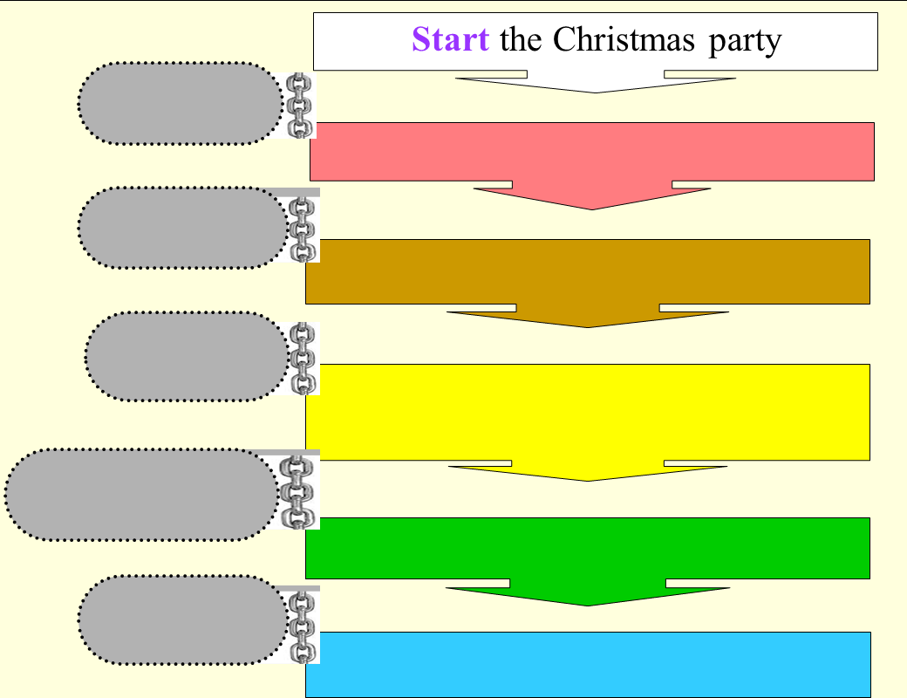
Writing about party activities
Flow chart with colour to show the sequence of the party activities

Slide 12
Learn to add details to various party activities
Core task: Colour the main ideas;
box the details in the paragraph
Use of colour contrast to show paragraph structure
12

Slide 13
Strategies for varying teaching process and material design
Scaffolding
Active learning (colour coding,
multiple intelligence- interpersonal)
Use flexible grouping
teaching process

Slide 14
Teacher-led small group instruction
(*alternative to class & individualised teaching)
How to make elaboration
4-6 Ss in the group (vary between classes)
Consider task nature, anticipated benefits on Ss, ‘chemistry’ among Ss
Set priority: Weak ones need additional instruction & remedial support in reading

Slide 15
Whole-class teaching
-Built on ‘main idea’ to introduce ‘Details’
- Gave instructions for WS
- Grouped Ss (simiar ability grouping)
Small-group teaching
(Completed 2 WSs)
Independent work
(Completed 3 WSs)
Direct teaching of using ‘What’
‘Why’ to make elaboration
Additional clarification &
explanation
- Individual attention to individuals
Removal of support to check Ss’ understanding
Average and higher proficient students had to work on one extra WS apart from the core tasks with no teacher support
Being given less time comparatively to complete the tasks, they were required to work more quickly on the tasks.
Whole-class teaching - Answer checking
- Debriefing (‘Main ideas’ & ‘Details’)

Slide 16
Adopt strategies
that suit all
Regular Class
Provide additional support to less proficient Ss

