Slide 1
Self-directed learning

Slide 2
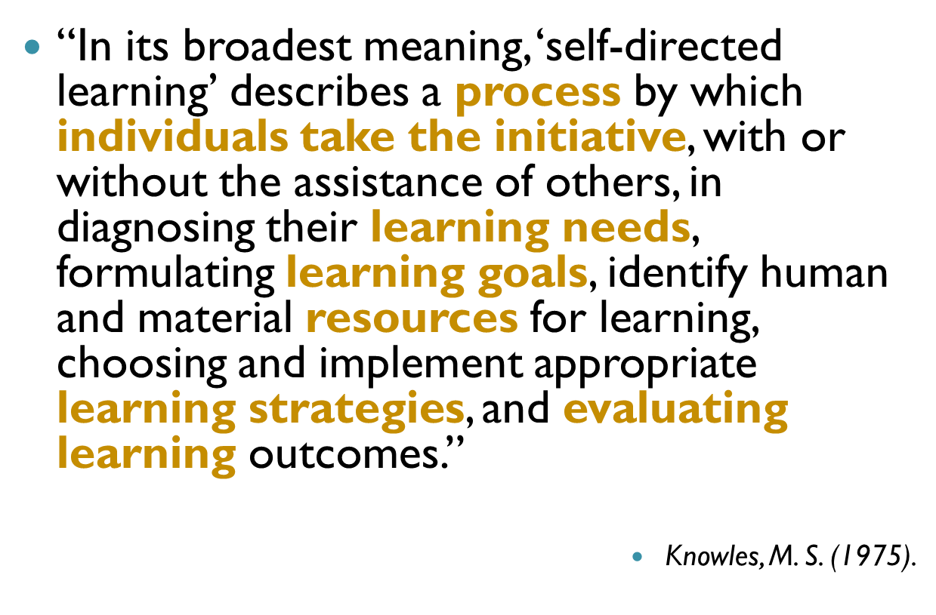
Definition of SDL
Notes:
To understand what self-directed learning is, we made reference to the definition given by Knowles. According to Knowles, self-directed learning means…

Slide 3
4 basic steps to achieve self-directed learning
Notes:
To realise the essence of SDL, it take a careful process. Based on the definition given by Knowles, four basic steps can be derived and they are:

Slide 4
Teacher- Learner-
directed directed
-
- Determined by T
- Assessment data driven (e.g. test, exam)
Experience difficulties in language use
Personal plans
1. Diagnosing learning needs & setting learning goals
2. Selecting learning resources and strategies
- Provided by teachers
Modelling
Instructions given
Self-selection by learners
3. Monitoring learning progress
Exercises
Activities
Assignments
Feedback/comment
Portfolios
Reflection logs
Learning diaries/contracts
4. Evaluating learning outcomes
Tests
Self-assessment
Reflections
Notes:
(Read out 1-4). …
What should be done in each stage of the SDL process depends on the readiness of your learners. For example in stage 1, …
If more teacher input is given at the earlier stages such as in primary levels, we should help our students move along the continuum so that the ultimate goal of independent learning can be achieved.
When implementing SDL, you can design various worksheets to fit into the different stages of the SDL process. In a minute, my colleague, Connie, will share with you some worksheets which are designed for the different stages of SDL.

Slide 5
Worksheet Analysis
There are 4 basic steps to achieve SDL:
Diagnosing learning needs and setting learning goals
Selecting learning resources and strategies
Monitoring learning progress
Evaluating learning outcomes
Some worksheets are designed to help students to become self-directed learners.
Which step(s) of SDL do these activities involve?

Slide 6
Situation 1:
The students will do a presentation on introducing Cheung Chau for this unit.
At the beginning of the series of lessons of this unit, teacher asks students to complete the K and W columns of the KWL chart.
Which step(s) of SDL does this activity involve?
Diagnosing learning needs and setting learning goals
Monitoring learning progress
Selecting learning resources and strategies
D. Evaluating learning outcomes

Slide 7
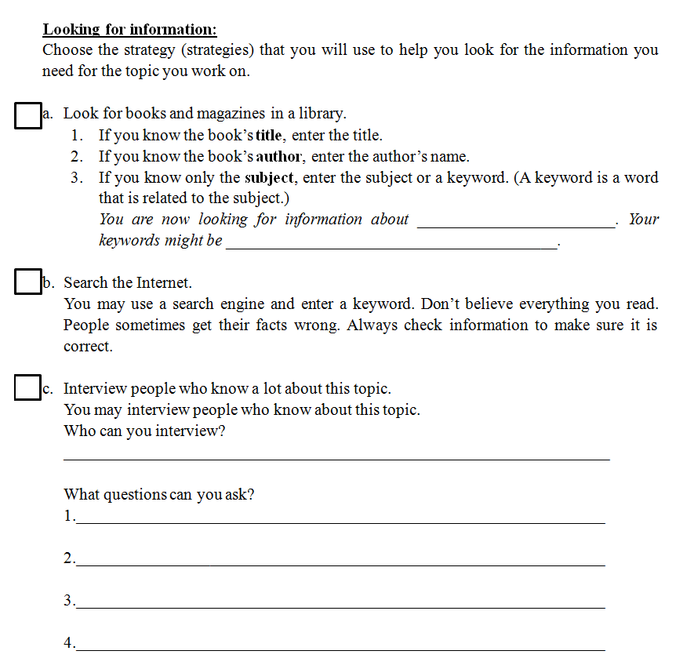
Situation 2:
To learn more about Cheung Chau, teacher gives students the following instructions to find more information .
Which step(s) of SDL does this activity involve?
Diagnosing learning needs and setting learning goals
Selecting learning resources and strategies
Monitoring learning progress
D. Evaluating learning outcomes

Slide 8
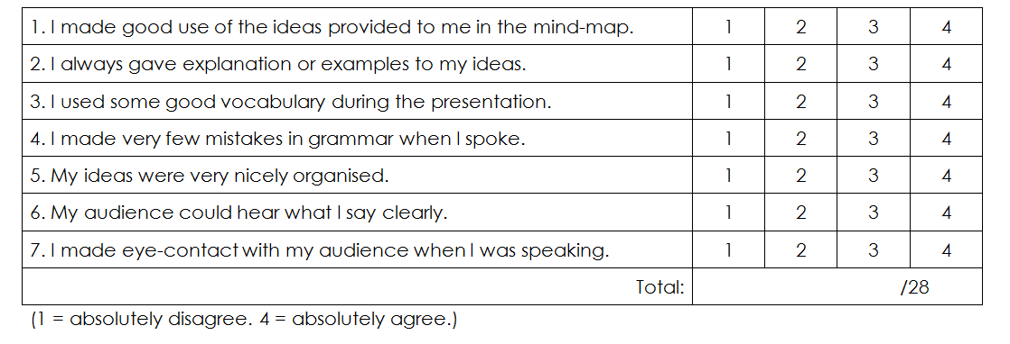
Situation 3:
After doing a presentation on introducing Cheung Chau based on the mind-map the students have constructed, they complete the following table.
Which step(s) of SDL does this activity involve?
Diagnosing learning needs and setting learning goals
Monitoring learning progress
Selecting learning resources and strategies
D. Evaluating learning outcomes

Slide 9
Situation 4:
After completing the evaluation form that has just been shown, students have to answer the following question.
What can I do better next time?
__________________________
Which step(s) of SDL does this activity involve?
Diagnosing learning needs and setting learning goals
Monitoring learning progress
Selecting learning resources and strategies
D. Evaluating learning outcomes

Slide 10
Situation 5:
To prepare for the dictation, students complete the following worksheet:
Which step(s) of SDL does this activity involve?
Diagnosing learning needs and setting learning goals
Monitoring learning progress
Selecting learning resources and strategies
D. Evaluating learning outcomes

Slide 11
School cases
School-based examples | Vocabulary learning -> speaking Vocabulary learning -> writing

Slide 12
Level: P3
Learning vocabulary for describing dishes and do a presentation on a favourite dish
to help students learn vocabulary and apply them in context
to cater for learner diversity
to create space for tasks that required higher order thinking skills in class

Slide 13
Identifying learning needs and setting learning goals
Describing a favourite dish
Vocabulary about common ingredients
Vocabulary for describing tastes
2. Selecting learning strategies
Quizlet (Flashcards)
Look, say, cover, spell, check / Look, spell, cover, write, check
3. Monitoring learning progress & Evaluating learning
outcomes
Quizlet (Scatter, Learn, Speller, Gravity)

Slide 14
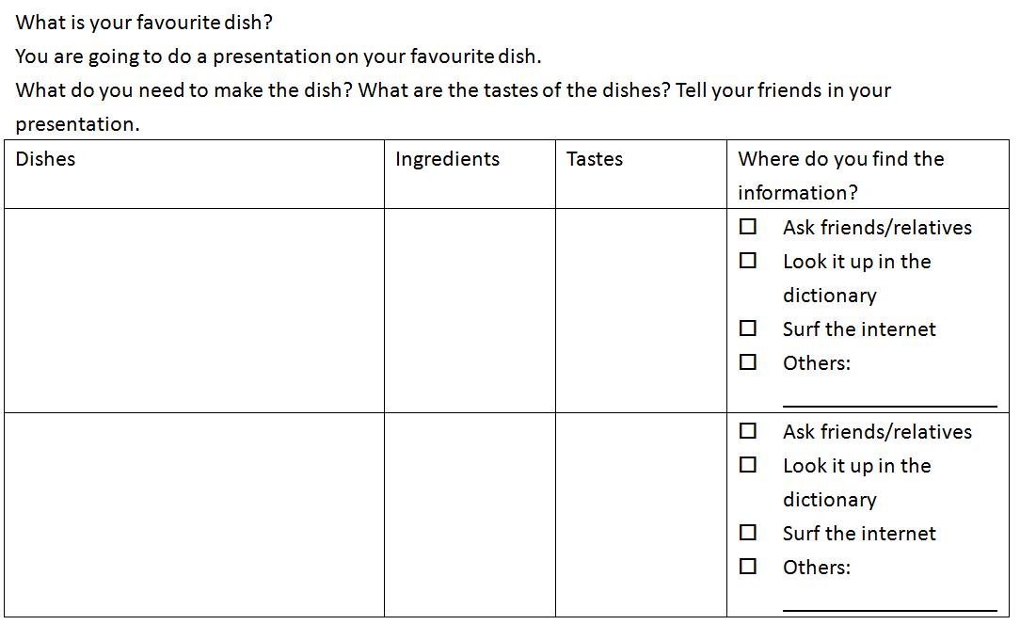
Identifying learning needs and setting learning goals

Slide 15
Identifying learning needs and setting learning goals
Describing a favourite dish
Vocabulary about common ingredients
Vocabulary for describing tastes
2. Selecting learning strategies
Quizlet (Flashcards)
Look, say, cover, spell, check / Look, spell, cover, write, check
3. Monitoring learning progress & Evaluating learning
outcomes
Quizlet (Scatter, Learn, Speller, Gravity)

Slide 16
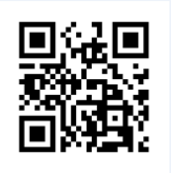
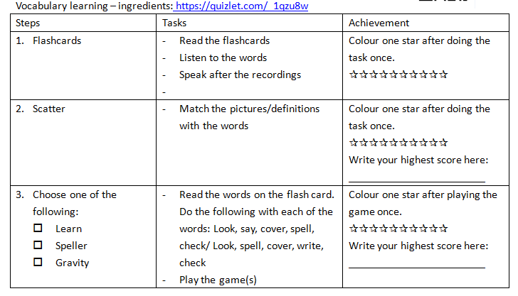
https://quizlet.com/_1qzu8w

Slide 17
monitor learning progress
https://quizlet.com/_1qzu8w
monitoring learning progress &
evaluating learning outcomes
monitoring learning progress &
evaluating learning outcomes
selecting learning strategies

Slide 18
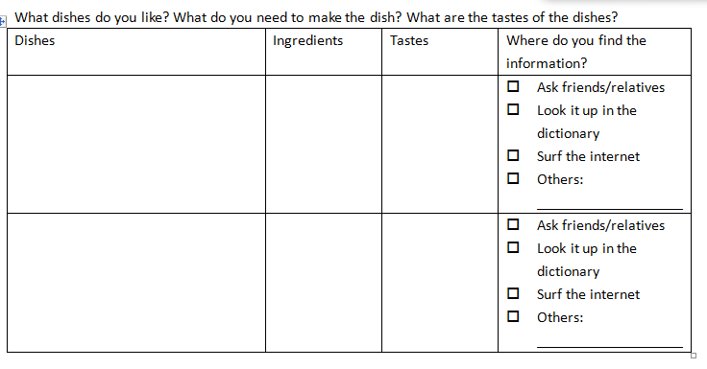
selecting learning resources
monitoring progress
evaluating learning outcomes

Slide 19
Level: P2
Unit 3 : Our school
SDL task: Learn more words about school facilities
Application: writing
Acknowledgement: CCC Kei Faat Primary School

Slide 20
Level: P2 Topic: Our school
Diagnosing learning needs and setting learning goals
Students need to expand their vocabulary on school facilities for accomplishing a writing task
2. Selecting learning resources and strategies
Apply the use of e-resources to facilitate vocabulary learning
3. Monitoring learning progress
Encourage students to keep a record of the new words learned and share in class
4. Evaluating learning outcomes
Assess students’ reporting on the new words learned
Assess students’ vocabulary learning record
Assess students’ writing to see if they can apply the words learned in use
Notes:
This school case is a P2 case and the topic is called ‘Our school’. I would like to express my special thanks to CCC Kei Faat Primary School for collaborating with me in working out this unit. We basically followed the 4 basic steps to conduct SDL.
First we… Teachers found that there is a need for students to improve their vocabulary learning, so it is stated in the subject plan that students in all level should do self-directed learning to acquire more words. A more teacher-directed approach is adopted in the SDL process. Teachers help students in different levels to set learning goals. So in P1…. In P2.. In P4-6..
After diagnosing needs and setting learning goals, teachers help students select learning resources. The use of e-resources was applied in the SDL process. So, in the unit planning, we start with … At the end of the unit, students were given 2 websites and they had to browse the websites and learn new words from them. After they have entered the website, they can see a pulldown menu with words related to school facilities. So, they can learn the new words by clicking them. A photo of the school facility will be shown together with the word so that students can get the meaning of the word. They could the copy the words into their ‘Word bank’.
To monitor the learning process, students can review their ‘word bank’ and see what new words they have learned and teachers can also check the booklet from time to time.
In stage 4, evaluating learning outcomes, we basically…(read the points). As you can see from the student writing, students tried to use some of the new words learned when writing about their dream school.
We found that the first try-out on SDL was a success and students were able to learn more words with appropriate input given. They could learn at their own pace and at their own time and they can also keep a good record of what they have learned. It is hoped that through implement SDL, students can be more motivated to learn and learn more independently.

Slide 21
Conclusion
Notes:
To sum up, when teachers promote SDL in school, there are a few points to note:

Slide 22
Provide students with opportunities for...
Understanding their as learners and setting achievable ______
Selecting learning ___________and learning ____________
Monitoring _______________
__________ and revision
needs
goals
strategies
resources
learning process
Assessment

