Slide 1
Conclusion drawn from the 3 presentations

Slide 2
e-
learning
Self-directed learning
(SDL)
Reading across the Curriculum (RaC)
Creativity
Information technology
21st Century learner
Critical thinking
Self-management
Communication
Collaboration

Slide 3
Implications for schools
What
Not doing all initiatives at the same time, but one at a time
When
Availability of resources
Teachers’ readiness
Students’ readiness
How
Think big (holistic planning)
Start small (working team)
Provide support (space and training)

Slide 4
Reading across the Curriculum (RaC)
Deepen
Sustain
Inter-relatedness
Self-directed learning
(SDL)
e-
Learning
focus

Slide 5
English Language Learning Support Services
Language Learning Support Section (LLSS), EDB

Slide 6




Professional Development Activities
School-based Curriculum Resources
On-site Support
Language Learning Support Section
Provide support services to meet schools’ specific needs

Slide 7
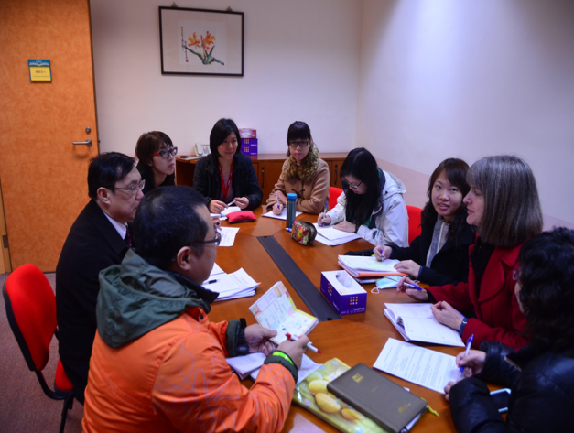
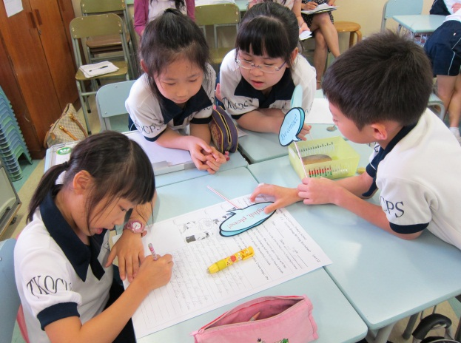
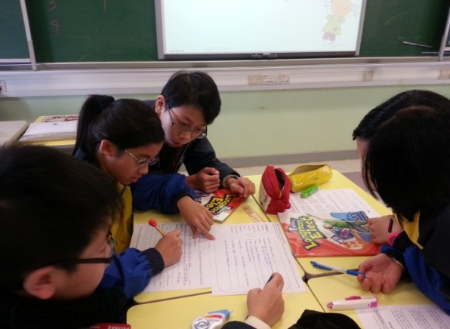
Promoting LaC and holistic curriculum planning
Language Learning Support Section
Addressing learner diversity through different L/T strategies
Enhancing assessment literacy
Address the concerns of panel heads, coordinators and teachers

Slide 8

Some examples of support focuses
Reading and writing across the curriculum
Supporting a smooth transition across Key
Stages
Self-directed and e-learning
Values education and careers education
Development of the four language and thinking skills under a task-based framework

Slide 9
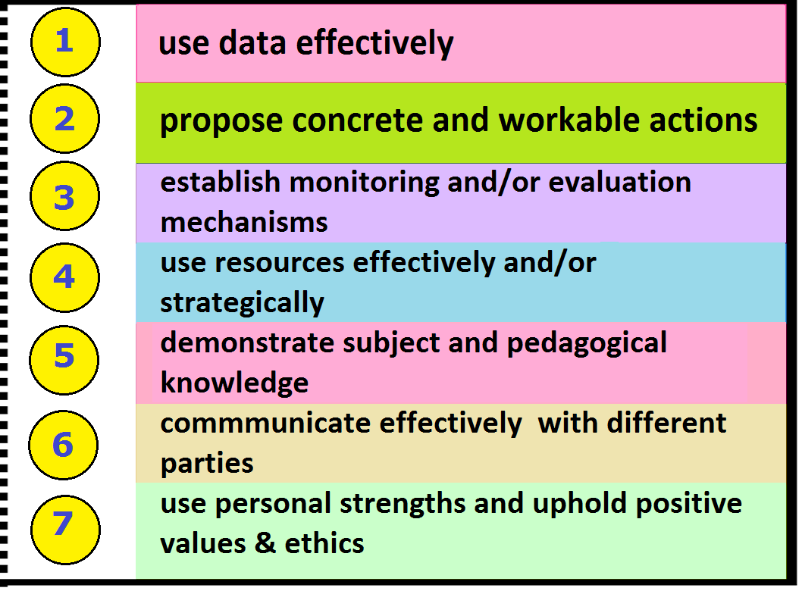
Curriculum Leadership Development Programme
It aims at developing teachers’ capability to …
Language Learning Support Section

Slide 10













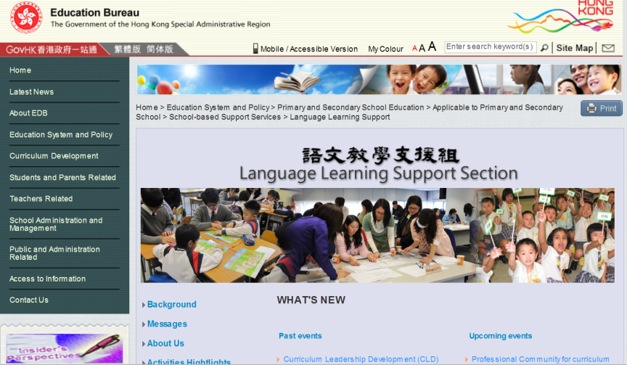










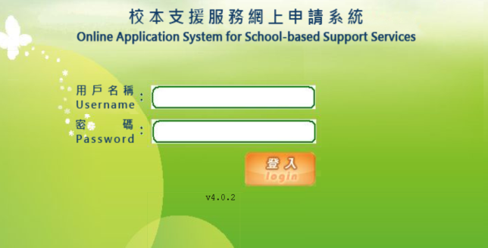
More information about LLSS
Language Learning Support Section
LLSS homepage
LLSS publications
LLSS contact person:
Ms Amy POON, Senior Curriculum Officer
E-mail: ayypoon@edb.gov.hk Tel.: 3698 4093
LLSS Website:
http://cd1.edb.hkedcity.net/cd/languagesupport/
Online application system for support services: https://sbssapplication.edb.gov.hk/login.php

Slide 11
The End
Please complete the evaluation questionnaire before you leave
Leave the school information for future contact

