Slide 1
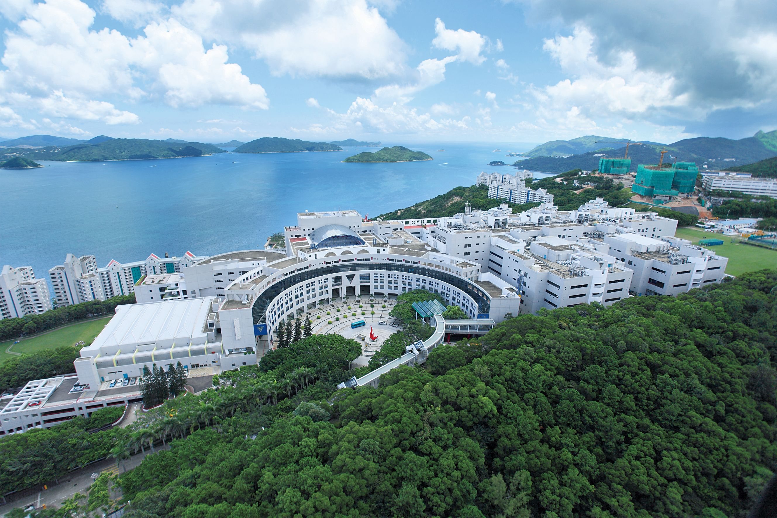
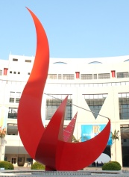

Student Learning Profile (SLP) - The Way Forward
JOIN.HKUST
A sharing by Betty Law
Associate Director
UG Recruitment and Admissions Office

Slide 2


SLP, OEA …
Who I now am
Strengths
Interests
Aspiration
…
SLP
My Dreams
Who I will be
Personal statement
1-page CV
OEA
Future CV

Slide 3
SLP, OEA …
- In the eyes of HKUST admissions
Quality vs Quantity
Interest, passion, motivation
Leadership role
Community services
Consistent story, genuine story
School assessment on personal qualities
Grammar, writing style – not a major concern
OEA assessment at UST:
It is an ART!!
A labor intensive process !!
Not a mechanic scoring process!!

Slide 4
SLP, OEA, JUPAS choices …
- A consistent story
HKDSE Results Eligible for admission? Weighted DSE score | Program Choices: Band A-C
 | Academic performance in School Percentile and rating
Personal & general abilities
Additional Information (personal statement)
OEA entries
OEA assessment at UST:
It is an ART!!
A very labor intensive process !!
NOT a mechanical scoring process!!

Slide 5
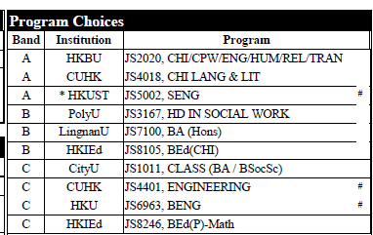
Example 1
Illustrative Example 1
- An Engineering (JS5002) applicant

Slide 6
Example 1
Illustrative Example 1
- An Engineering (JS5002) applicant
Drama has changed my life...
Chinese Speaking Competition …
Performed more than twenty times…
Assistant Stage Manager and the Art Director …
Labeled as a bookworm…
Experiences in writing scripts for different plays...
I hope to be an expert on words

Slide 7
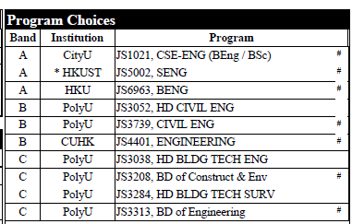
Example 2
Illustrative Example 2
- An Engineering (JS5002) applicant

Slide 8
Example 2
Illustrative Example 2
- An Engineering (JS5002) applicant
a deep interest in physics and maths
Buildings, operating and controlling machines … are really fascinating
Engineering …suits me most … apply the theories into reallife
Joining ‘Solar Energy Lights the World Up’ … fostered my interest in engineering
volunteer services → leadership … communication skills … team spirit… sense of social responsibility → prerequisites for engaging myself in engineering inventions and operations

Slide 9
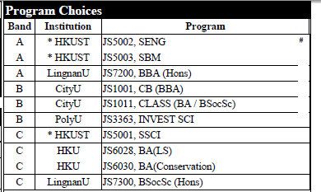
Example 3
Illustrative Example 3
- An Engineering (JS5002) applicant
Interior Designer is my dream job
I am interest in devise, particularly three-D devise
For me,Interior Design is the most attractive
enjoy creating a new design and feel sucessful

Slide 10
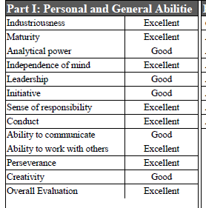
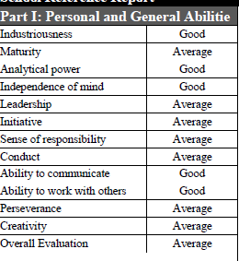
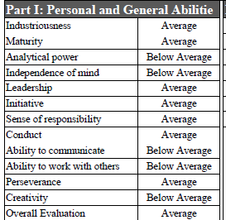
Example 3
School Reference Report

Slide 11
Examples: OEA entries
Examples of OEA entries
周會(認識網上犯罪),小心上網
長者安居服務協會賣旗日
國慶慶祝活動(認識國家)
Career-related activities: JUPAS workshop
The chairperson of the School Athletic Club
XXX competition - senior individual champion

Slide 12
Examples: OEA entries
SLP, OEA …
- Final remarks
Do we care? A definite YES!
Definitely worth the efforts
students’ and teachers’
for admission and for future planning
Personal statement
The longer the better??
Important to have a consistent story
Impact: Bonus added to HKDSE score

