Slide 1
Causal Explanation

Slide 2
Q1(pre-test)：
As shown in the figure, a beam of α-particles emitted from a radioactive resource enters the space between a pair of metal plates. Explain why do the α-particles deflect to the negative poles when switch S closes.
a pair of metal plates
a pair of metal plates
α
α
Radioactive source
Radioactive source
S
Switch S
Switch S

Slide 3
Suggested Answer：
When switch S closes, α-particles will deflect to the negative pole. The reasons are as below.
When switch S closes, an electric field is formed between the two parallel metal plates.
On the other hand, α-particles have positive charges.
When the α-particles enter the electric field, they will experience an electric force and deflect to the plane of negative pole.

Slide 4
Schematic Structure
Structure |  | Content | Language Features
Identification of phenomenon |  | When switch S closes, a- particles will deflect to the negative pole. The reasons are as below. | When… The reasons are as below.
Absence of factor |  | When switch S closes, an electric field is formed between the two parallel metal plates. | When…
Presence of factor | Explanation Sequence 1 | On the other hand, α-particles have positive charges. | On the other hand, …
 | Explanation Sequence 2 | When the α-particles enter the electric field, they will experience an electric force and deflect to the plane of negative pole. | When…

Slide 5
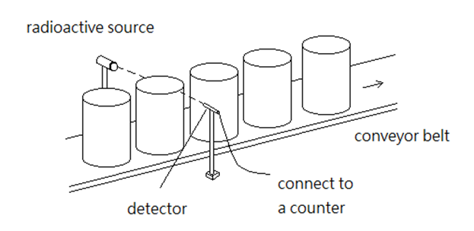
Example 2
A factory producing bottles of detergent uses a method as shown to check the quantity of detergent inside the bottles. At both sides of conveyor belt, there is a set of radioactivity source(β), detector and counter. Both the source and detector are set at the level as the standard height for the detergent inside the bottle to reach (see the following figure).
Explain how this system can identify the irregular products (that the detergent inside the bottle does not reach the standard height).

Slide 6
Suggested answer
When the detergent inside the bottle does not reach the standard height, the reading of counter is greater than the normal. The reasons are as follows. In normal condition, the detergent inside the bottle reaches the standard height. Majority of β radiations will be absorbed by the detergent and is not able reach the detector. Thus, the counter records only few β radiations and background radiation. When the detergent inside the bottle does not reach the standard height, β radiations will not be absorbed and thus they will reach the detector. The reader of counter goes up and the irregular product can be identified.

Slide 7
Schematic Structure
Structure | Content | Language Features
Identification of phenomenon | When the detergent inside the bottle does not reach the standard height, the reading of counter is greater than the normal. The reasons are as follows. | When… The reasons are as follows
Absence of factor | In normal condition, the detergent inside the bottle reaches the standard height. Majority of β radiations will be absorbed by the detergent and is not able reach the detector. Thus, the counter records only few β radiations and background radiation. | In normal condition,… Thus
Presence of factor | When the detergent inside the bottle does not reach the standard height, β radiations will not be absorbed and thus they will reach the detector. The reader of counter goes up and the irregular product can be identified. | When… and thus…

Slide 8
Schematic Structure of Casual Explanation
Structure | Contents and Functions | Language features
Identification of phenomenon | State clearly the things or phenomena to be explained by identifying the causes and effects. | Use “If…” and “when…” to bring out the condition and cause. Clause “the reason for…” always brings out the following explanation.
Explanation Sequence (could be divided by ‘Absence of factor’ and ‘Presence of factor’ | Explain the various characteristics of things or accounts for the different reasons of the occurrence of the phenomena in paragraphs | Use words to express the cause and effect, such as “Because”, “because of”, “due to”, ”resulting in”, “since”, “caused by”, “leading to”, “thus”, “hence”, “so that” … etc.
Conclusion (optional) | Summarize the explanation | Conjunction “Therefore”, “Hence” and “Thus” always brings out the conclusion

