Slide 1
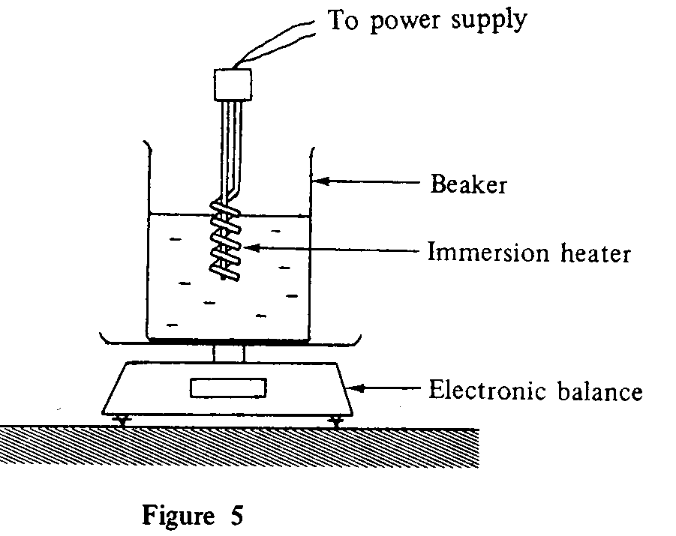
Understanding Theoretical Explanation
Case 1: Boiling water
A student performs an experiment to find the specific latent heat of vaporization of water. The water is heated by an immersion heater, which is immersed in the water, as shown in the figure.
The student finds that the mass of water decreases while boiling. Explain your answer in terms of molecular motion.

Slide 2
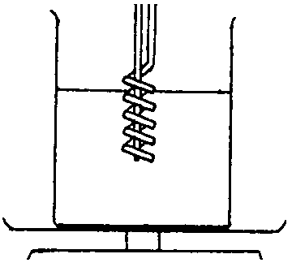
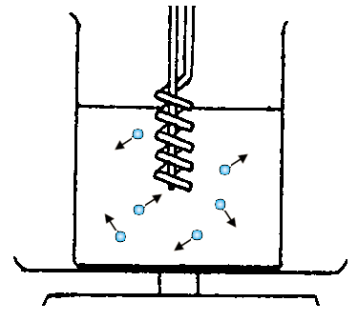
Show the motion of water molecules at both:
(i) 70°C, and
(ii) boiling(100°C).
Before heating
at 70°C
Boiling (at 100 °C)

Slide 3
In terms of kinetic theory, explain the motion of water molecules at both:
(i) 70°C, and
(ii) boiling(100°C).
Motion of water molecules | Explain in terms of kinetic theory
70°C When water is heated by the immersion heater, the water molecules move faster. | the average kinetic energy of the water molecules increases.
(ii) boiling(100°C). When water temperature reaches the boiling, some molecules escape from the beaker. | some water molecules overcome the backward pull of other molecules. As a result, the water molecules escape the water surface as gas molecules.

Slide 4
Suggested Answer
According to kinetic theory of matter, water consists of a large number of molecules moving in all directions.
When water is heated by the immersion heater, the average kinetic energy of the water molecules increases. When water temperature reaches the boiling point, some water molecules overcome the backward pull of other molecules. As a result, the water molecules escape the water surface as gas molecules.
Thus, the mass of water decreases while it is boiling.

Slide 5
Deconstruction of the Suggested Answer
Step | Structure | Answers
1 | Statement of Theory | According to kinetic theory of matter, water consists of a large number of molecules moving in all directions.
2 | Explanation Sequence (Relate the theory to condition) | When water is heated by the immersion heater, the average kinetic energy of the water molecules increases. When water temperature reaches the boiling point, some water molecules overcome the backward pull of other molecules. As a result, the water molecules escape the water surface as gas molecules.
3 | Conclusion | Thus, the mass of water decreases while it is boiling.

