Slide 1
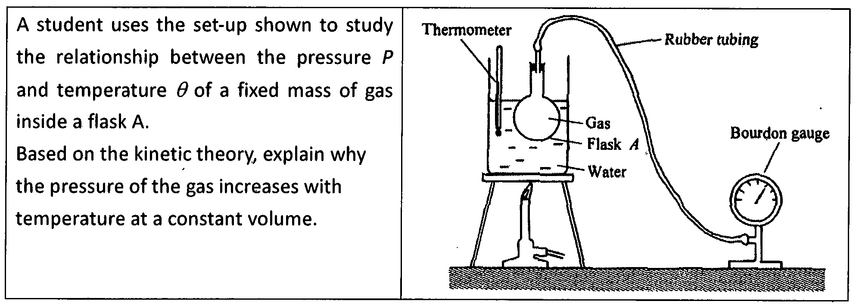
Case 3 : P - T Relationship

Slide 2
Suggested Answer
According to kinetic theory of matter, gases consist of a large number of air particles moving randomly in all directions. When the temperature increases at constant volume, the particles gain more kinetic energy and move faster. Hence the particles collide the walls of flask more frequent and harder(with a greater force). As a result, it leads to the increase of gas pressure. Therefore, the pressure of the gas increases with temperature at a constant volume.

Slide 3
Rubrics for Writing Assignment on Theoretical Explanation
Items | Good | Average | Need to improve
Content Knowledge, such as: state relevant theory, laws or principles relate the concepts to the events and phenomena properly
Text Structure, such as: begin with statement of theory followed by proper explanation sequence conclude with summary statement, if any
Use of Language, such as: use conjunctions properly correct spelling & grammatically correct language

Slide 4
Deconstruction of Answer (Text Structure)
Step | Structure | Answer
1 | Statement of Theory | According to kinetic theory of matter, gases consist of a large number of air particles moving randomly in all directions.
2 | Explanation Sequence (Relate the theory to condition) | When the temperature increases at constant volume, the particles gain more kinetic energy and move faster. Hence the particles collide the walls of flask more frequent and harder(with a greater force). As a result, it leads to the increase of gas pressure.
3 | Conclusion | Therefore, the pressure of the gas increases with temperature at a constant volume.

Slide 5
Deconstruction of Answer (use of language)
Step | Structure | Answer
1 | Statement of Theory | According to kinetic theory of matter, gases consist of a large number of air particles moving randomly in all directions.
2 | Explanation Sequence (Relate the theory to condition) | When the temperature increases at constant volume, the particles gain more kinetic energy and move faster. Hence the particles collide the walls of flask more frequent and harder(with a greater force). As a result, it leads to the increase of gas pressure.
3 | Conclusion | Therefore, the pressure of the gas increases with temperature at a constant volume.

Slide 6
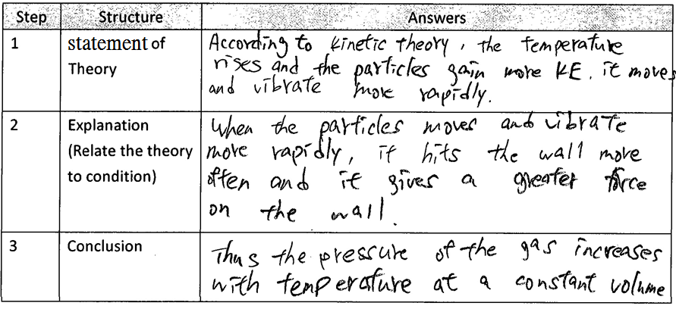
student Script 1 (should be collected from your students)
Items | Good | Average | Need to improve
Content Knowledge
Text Structure
Use of Language

Slide 7
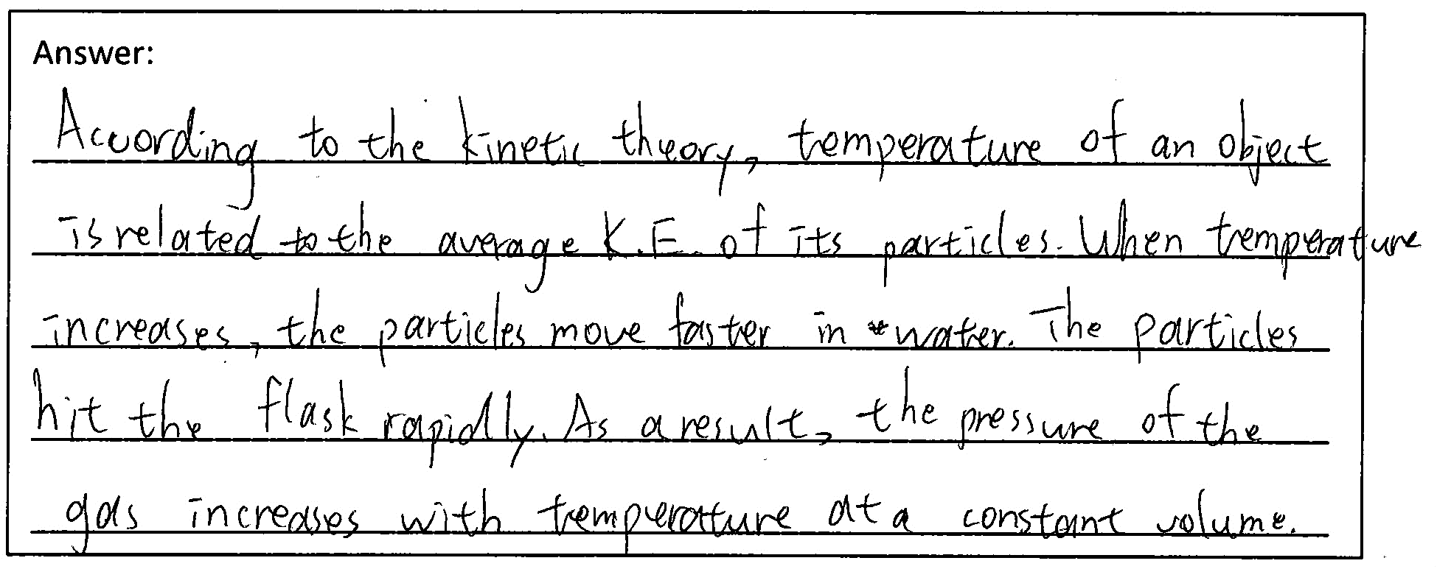
student Script 1 (should be collected from your students)
Items | Good | Average | Need to improve
Content Knowledge
Text Structure
Use of Language

Slide 8
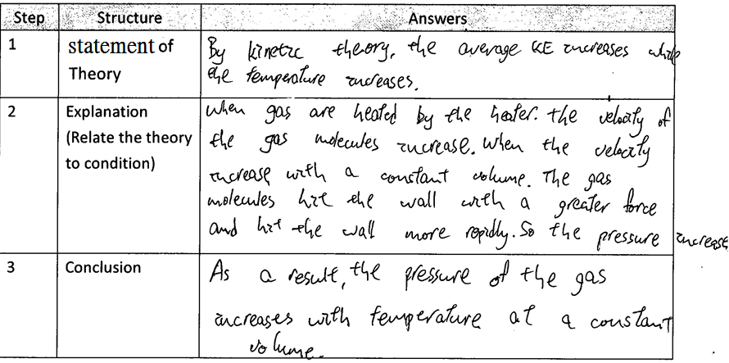
student Script 1 (should be collected from your students)
Items | Good | Average | Need to improve
Content Knowledge
Text Structure
Use of Language

