Slide 1
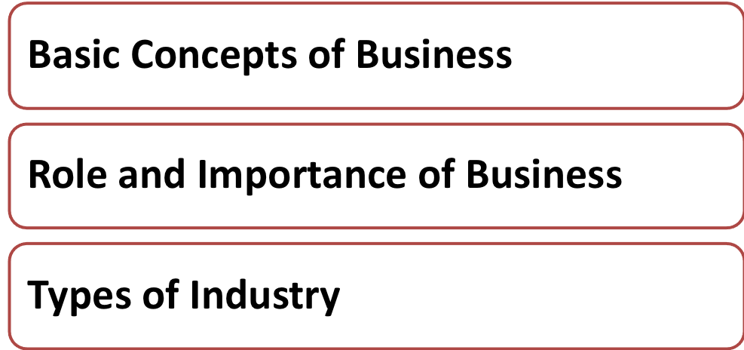
Lesson 1

Slide 2
What would you do if you were bitten by bees?

Slide 3
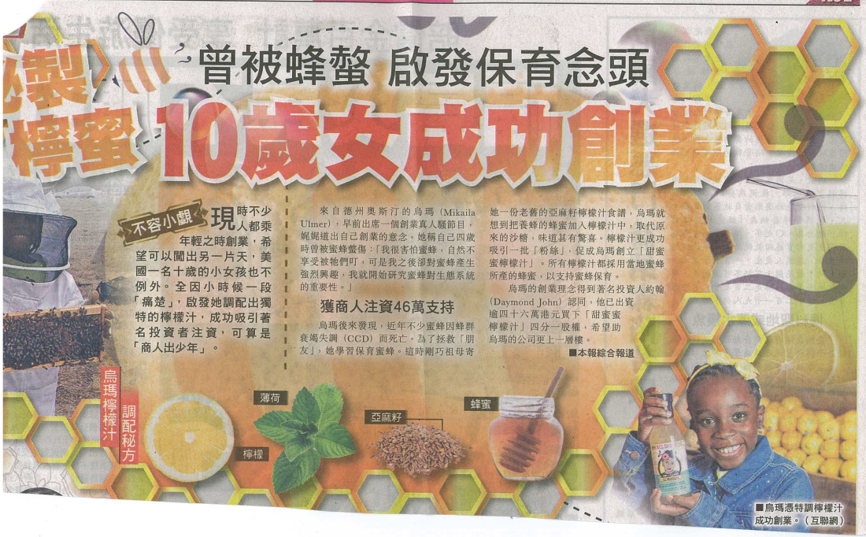
Sto
Source: Oriental Daily, 30 March, 2015
Notes:
Arouse students’ learning interest by an interesting story.
Stimulate students to think that business involves a business idea and investment, exchanging something of value and reward for taking risks.

Slide 4
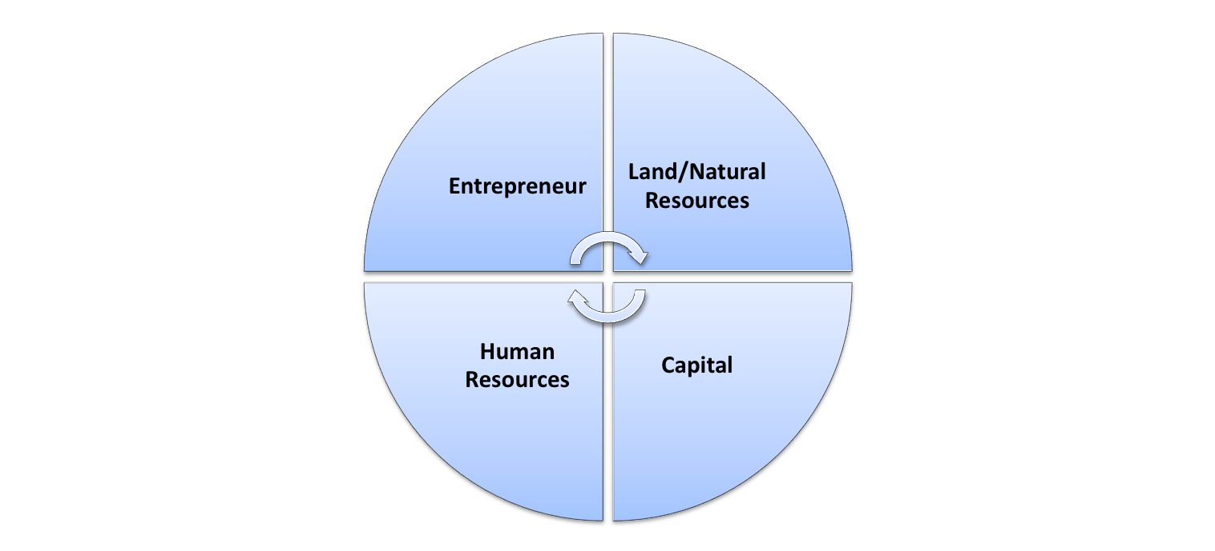
What Is Business?
The organised effort of individuals to produce and sell, for a profit, the goods and services that satisfy customers’ and society’s needs.
Notes:
Factors of production for a typical production unit include human resources/labour, capital (equipment and machine, fund), natural resources and entrepreneurship.
If the business is successful, entrepreneurs will enjoy profit for taking risk.

Slide 5
Class Activity (1) – Group Discussion
Have you ever called a taxi or van via mobile apps?
Have you ever brought items from an auction or on-line shopping website?
Notes:
Students are asked to do Worksheet (1) on the examples of GoGo Van and eBay, teacher then explains the concept of “Business model”– how a business generates revenue and earn profit.

Slide 6
What Is Business?
We approach drivers, ask them to sign up with us, and get them jobs via the app. We will take a percentage of their pay as commission.
Using mobile apps and call centres as the device, customers are offered a more efficient way to call vans.
The company is expanding to other Asian regions.
SCMP, 13 October, 2014
Notes:
Uber is a similar example.

Slide 7
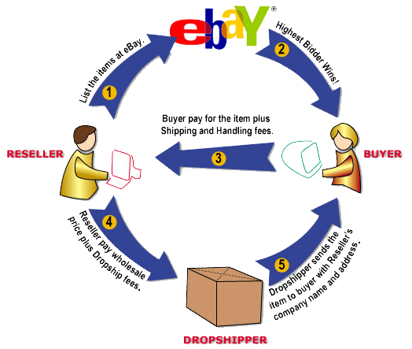
What Is Business?
ebay is a popular channel for auctioning collectibles and the company collects transaction fees based on a percentage of sales.
Notes:
It is an online person-to-person trading community on the Internet. Buyers and sellers are brought together in a manner where sellers are allowed to list items for sale and buyers to bid on items of interest, both sellers and buyers are also able to browse through all listed items.

Slide 8
What Is Business?
Notes:
Teacher concludes students’ answer on Worksheet (1) and explains the meaning of business.

Slide 9
Role and importance of Business
Providing employment opportunities
Satisfying consumers’ needs and wants by producing goods and providing services
Generating income for people and government
Promoting economic growth and raising people’s living standard
Notes:
Teacher wraps up by highlighting the role and importance of business in Hong Kong.

Slide 10
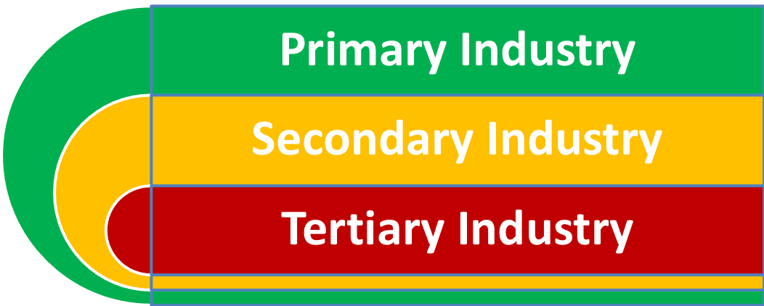
Types of Industry
Notes:
These three types of industry have a close relationship and they are also interrelated. Primary production needs products and inputs from secondary production, likewise, secondary production also needs inputs and raw materials from primary production, and finally, both industries will need services from tertiary production. This indicates the fact that economic activities usually are not confined to one single type of industry.

Slide 11
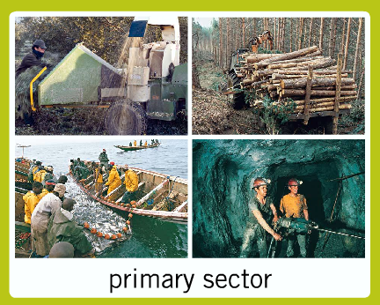
Primary Industry
All activities that directly extract or utilise natural resources in the process of production
e.g. agriculture and fisheries, mining and quarrying
Notes:
More examples include fishing of salmon in Norway and Canada; planting coffee beans in Brazil; agriculture in Thailand and Vietnam; timbering in Indonesia, etc.

Slide 12
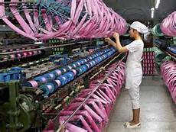
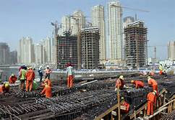
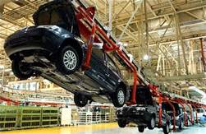
Secondary Industry
All process of turning raw materials into finished goods or semi-finished goods
e.g. manufacturing; construction; and the supply of electricity, gas and water
Notes:
There are a lot of manufacturing factories in the Mainland and it is called “The World’s Factory”. Owing to the rising costs in the Mainland, in recent years, more and more Hong Kong manufacturing factories are located in less-developed countries such as Vietnam, Sri Lanka, Cambodia, etc. There remains some high-value added manufacturing industries in Hong Kong now.

Slide 13
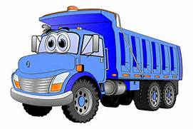
Tertiary Industry
All economic activities that provide services to business and consumers
e.g. wholesale, retail and import/export trade; restaurants and hotels; transport, storage and communications; financing, insurance, real estate and business services
Notes:
Many affluent countries transformed themselves from a manufacturing-based economy to a service-based one. These countries focus more on service industries.

Slide 14
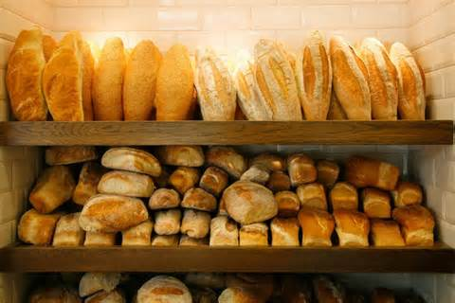
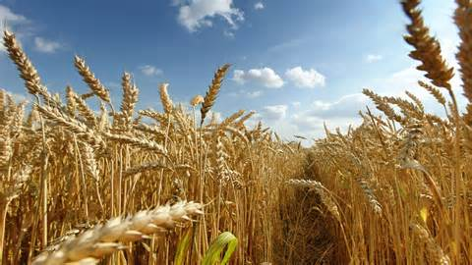
Interdependence of Industry – Example 1
Notes:
A good way to understand what any business does is to view it as a system for satisfying customers by transforming lower-value inputs into higher-value outputs, from primary to secondary and finally to tertiary production.
14

Slide 15
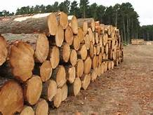
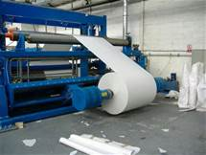
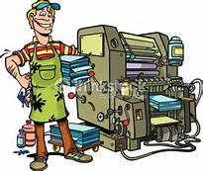
Interdependence of Industry – Example 2
Notes:
15

Slide 16
From the statistical tables, describe any observations and identify reasons for the trend of the three types of industry.
Write down your group’s observation on Worksheet 2 .
Table 1,2,3
Notes:
Teacher distributes Worksheet 2 to students in groups of 4-5, and asks them to study the data in detail and discuss their observations about the economic activities in Hong Kong.
Table 1: Percentage contribution to Gross Domestic Product (GDP) by economic activity (at current prices)
Table 2: Number of Establishments by industry section
Table 3: Number of Persons Engaged (other than those in civil service) by industry section

Slide 17
Trend
Insignificant and stable portion of primary industry
Shrinking manufacturing sector
A very high % of service industries
More construction work in recent years
Notes:
Teacher asks each group to present their views and then concludes this part by summing up the trend of economic activities in Hong Kong.
Students may be able to observe other phenomenon, for examples:
flourishing service sector: many property agencies during property market boom and many retail shops and restaurants
lack of construction workers due to many infrastructure and construction work projects
not many factories in Hong Kong

Slide 18
Reasons for the trend
lack of natural resources for primary production
manufacturing factories moved to Mainland China and other low-cost regions
more construction work because of more housing projects and infrastructure work in recent years
provide supporting and value-added services to companies → transforming into a service-oriented economy
Notes:
Teacher guides students to think about the reasons for the trend and checks the answers on Worksheet (2).

Slide 19
Under the existing industrial structure, what are the opportunities and potential risks to Hong Kong business?
Notes:
Teacher asks students to discuss in groups and put the answer to the above questions on Worksheet (2).

Slide 20
Opportunities:
Develop various kinds of service to meet diverse market needs
Attract foreign investment in service sector such as banking and finance sector
Strengthen the provision of professional services such as accountancy, legal, marketing, etc.
Risks:
Lack of industrial diversification and over reliance on service industries, in particular, finance and property
Service industries are more vulnerable to other countries’ economic setback
Weak in research and development activities for secondary industries
Notes:
Teacher responds to students’ answer and wraps up by explaining the opportunities and risks that Hong Kong businesses are facing.

