Slide 1
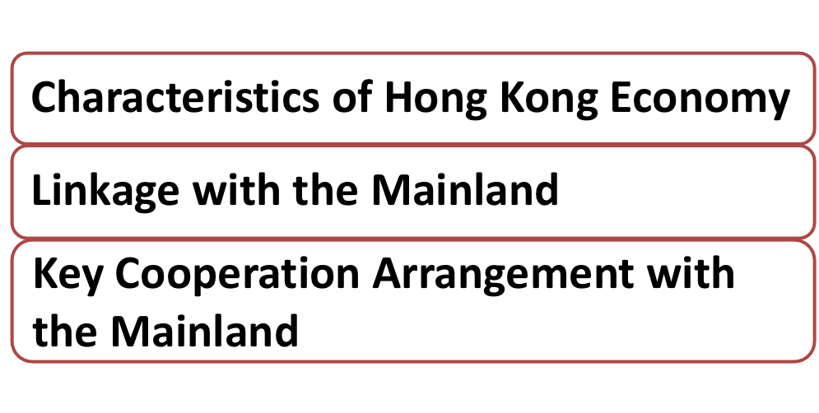
Lesson 2

Slide 2
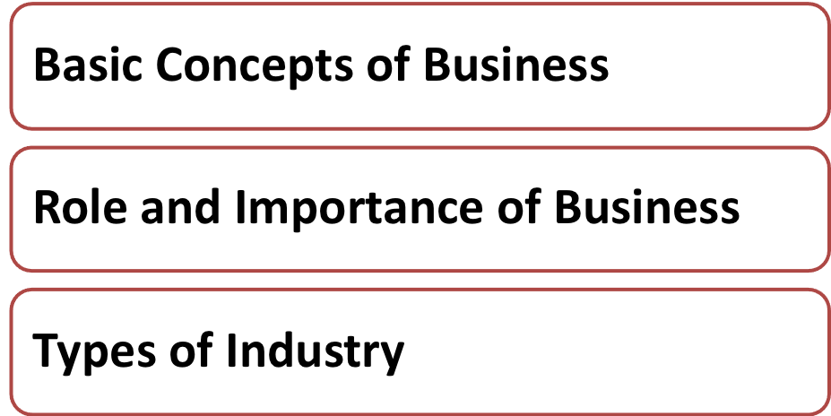
Last Lesson, you learnt ……
Notes:
Teacher recaps the meaning of business and Hong Kong industrial structure.

Slide 3
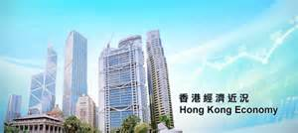
In your view, what are the characteristics of Hong Kong economy?
Notes:
Teacher asks students to describe the major characteristics of Hong Kong economy.

Slide 4
Lack of natural resources
Dependence on external trade
No foreign exchange control
Sound legal system and simple taxation system
Efficient infrastructure & communication system
Free and open economy
Notes:
Teacher wraps up:
Lack of natural resources – insignificant primary production, limited land for large manufacturing plants
Dependence on external trade – HK is an export-oriented economy as it lacks natural resources and relies on trade with other countries, HK needs to export products and services to earn foreign exchange in order to pay for its imports of goods or services
No foreign exchange control – capital is free to flow in and flow out
Sound legal system and simple taxation system – the legal system is well-established and independent from the Mainland; the tax rate is relatively low and without sales tax/value added tax
Efficient infrastructure & communication system – efficient transportation network such as airport and advanced communication facilities that facilitates free flow of information
Free and open economy – HK government basically has been adopting the laissez-faire policy; trade is free without barriers

Slide 5
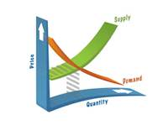
Market Forces:
Supply & Demand
Minimum
Government
Intervention
Free
Competition
Notes:
Teacher further explains the major features of free-market economy:
Markets are efficiently run that depend on demand and supply – “invisible hand”, prices of goods and services are determined by buyers and sellers.
Competition is free as Hong Kong is primarily adopting capitalism/market economy in which producers have the freedom to produce and sell for the pursuit of own private profits.
HK is basically free from government intervention (big market, small government), although recently the CE proposed that some “proactive measures” and “market enablers” are needed (適度有為).

Slide 6
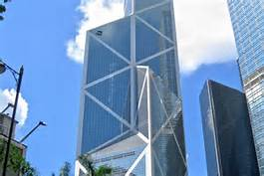
Let’s brainstorm
If a foreign company wants to set up its offices/operation units in Hong Kong, list the favourable factors to support the plan.
Notes:
Teacher asks students to think about the favourable factors for foreign companies to set up their business in Hong Kong with consideration of the characteristics and features of Hong Kong economy.

Slide 7
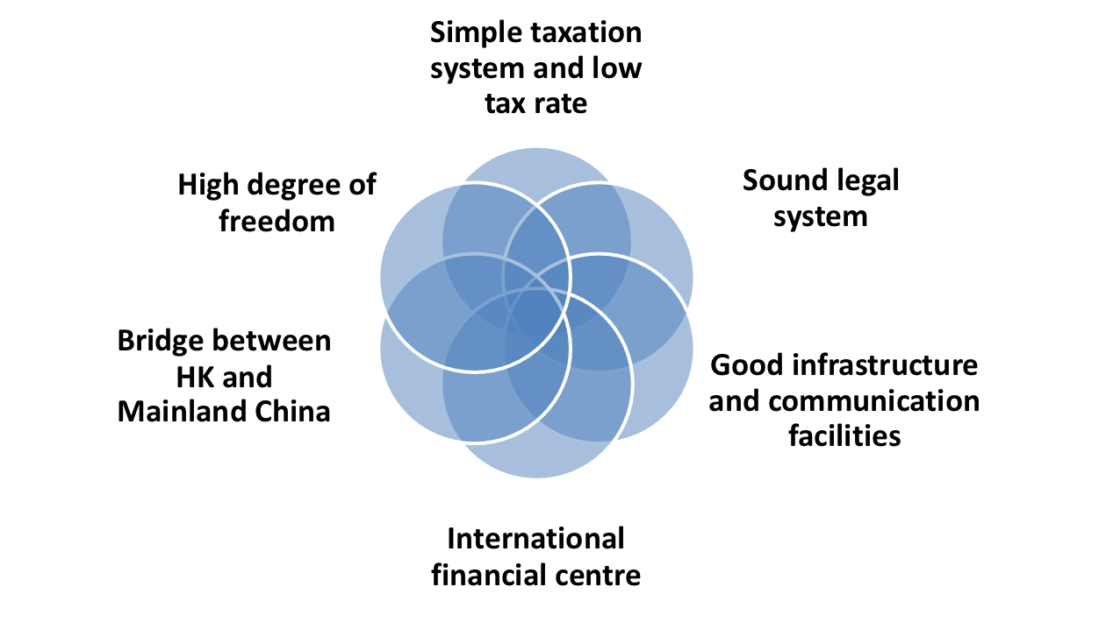
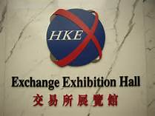
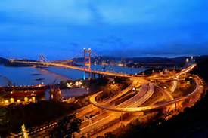
Favourable Factors
Notes:
Teacher explains that foreign firms can enjoy all these advantages if they set up offices or operation units in Hong Kong, an international city.

Slide 8
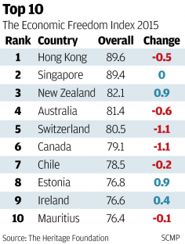
Favourable Factors
Hong Kong retains top spot as ‘world’s freest economy’ for 21st year in a row (SCMP, 28 Jan, 2015)

Slide 9
Favourable Factors
奧地利香港盼合璧 當創新之都 港有創業DNA 進入中國大門跳板
全球多(個)城市爭相做創新之都，單打獨鬥或難以在這場激烈競賽中勝出，以成為歐洲創新之都為目標的奧地利，成立「Global Incubator Network」（環球孵化網絡，簡稱GIN），擬與香港、新加坡和 ……. (HK Economic Times, 22 December, 2015)

Slide 10
Do you know ….
the recent developments of the Mainland?
Notes:
Teacher checks students awareness of major strategic development in the Mainland.

Slide 11
The Central Government has put forward the initiatives of building "One Belt One Road“ [Note 1]. These economic co-operation corridors, spanning different regions in Asia, Europe and Africa, will promote co-development among countries and foster co-operation in the political, economic and social areas. (source: HK SAR Government)
拓一帶一路 廠商會考察中亞
一帶一路是國家重點國策，十三五規劃大綱已訂明，香港在其中也有角色，港商也希望有機會分一杯羹。據知，中華廠商會會長李秀恆初步打算於明年初，率團到現代絲綢之路沿綫的中亞國家考察。
(Economic Times, 27 November, 2015)
Notes:
Teacher can refer to supplementary handout for further details: “One belt one road Extract of Budget Speech 2015-2016, Hong Kong Government” .
[Note 1]: In the policy address by Chief Executive Officer in 2016, the development plan was termed as “Belt and Road Initiatives”.

Slide 12
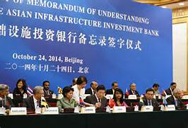
The China-led Asian Infrastructure Investment Bank (AIIB) is a multilateral development bank (MDB) conceived for the 21st century. It will complement and cooperate with the existing MDBs to jointly address the daunting infrastructure needs and focus on the development of infrastructure and other productive sectors in Asia and enhancement of regional connectivity.
Source: Yahoo pictures

Slide 13
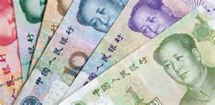
The International Monetary Fund (IMF) has approved the inclusion of the yuan among its Special Drawing Rights currencies at a board meeting in Washington ….
The addition will take effect on October 1, 2016. …. The move is seen as recognition of China's financial and economic progress after years of reform, though the authorities may take time to deliberate on how to further improve.
SCMP, 30 November, 2015
A significant step towards internationalisation of Renminbi.
Source: Yahoo pictures
Notes:
Effective date of Special Drawing Rights (SDR): October, 2016. Special drawing rights were created by the IMF in 1969 and were intended to be an asset held in foreign exchange reserves.
Weighting:
US$ 41.73%
Euro 30.93%
Renminbi/Yuan: 10.92%
Japanese Yen: 8.33%
British Pound: 8.09%

Slide 14
Class Activity (3) – Group Discussion
Can you describe Hong Kong’s linkage with the Mainland? Why should we be aware of the recent development of the Mainland?
Notes:
Teacher asks students to discuss in groups and put the answers to the above questions on Worksheet (3).

Slide 15
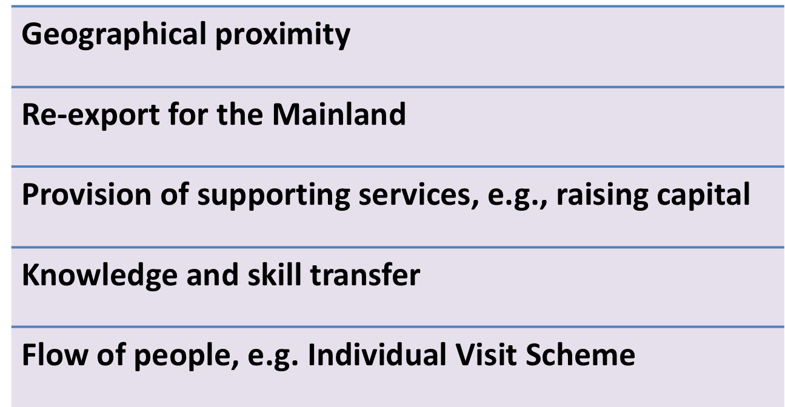
Notes:
Teacher asks each group to share their views, then wraps up the activity.
Geographical proximity – many foreign firms use HK as a gateway to the Mainland
Re-export for the Mainland – the Mainland is a large trading partner for HK and HK serves as a “middleman” in importing and exporting goods from and to other countries
Provision of supporting services, e.g., raising capital: HK is an international equity funding centre for the Mainland. Shares of the Mainland enterprises listed in Hong Kong take the form of H-shares, red chips and the Mainland private enterprises, constituted about 60% of the total market capitalisation in 2014, other than financial services, other supporting services include insurance, accounting, marketing, etc.
Knowledge and skill transfer, e.g. management expertise and IT knowledge – marketing managers will be employed in retailing companies in the Mainland and share the management and marketing knowledge
Flow of people, e.g. Individual Visit Scheme – tourism in HK is affected by the policy in the Mainland and the increase or drop in number of tourists also affect other industries such as hotel and catering, retailing, etc.

Slide 16
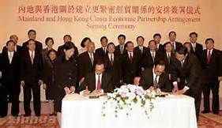
The Mainland and Hong Kong Closer Economic Partnership Arrangement (CEPA) is the first free trade agreement signed by the Mainland of China and Hong Kong in 2003.
CEPA adopts a building block approach, and the two sides have been working closely to introduce further liberalization measures continually.
CEPA opens up huge markets for Hong Kong goods and services, greatly enhancing the already close economic cooperation and integration between the Mainland and Hong Kong. (Source: HK Trade & Industry Department)
Notes:
Teacher can refer to supplementary handouts for further details.
CEPA benefits Hong Kong economy and business enterprises (HK Government)
CEPA助力兩地創富就業 (HK Commercial Daily Commentary, 28 Nov 2015)
“抓緊優惠商機爭取更大開放” (Sing Tao Daily, 28 Nov 2015)
“港與內地實現服貿自由化” (HK Commercial Daily, 30 Nov 2015)
“港要把握CEPA新機遇” (HK Commercial Daily, 1 Dec 2015)

Slide 17
Notes:
Teacher can refer to supplementary handouts for further details.
CEPA benefits Hong Kong economy and business enterprises (HK Government)
CEPA助力兩地創富就業 (HK Commercial Daily Commentary, 28 Nov 2015)
“抓緊優惠商機爭取更大開放” (Sing Tao Daily, 28 Nov 2015)
“港與內地實現服貿自由化” (HK Commercial Daily, 30 Nov 2015)
“港要把握CEPA新機遇” (HK Commercial Daily, 1 Dec 2015)

Slide 18
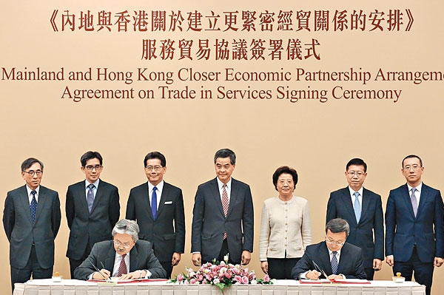
曾俊華指《服貿》助港企吸資
財政司司長曾俊華昨天撰寫網誌，表示在上周五（27日）代表特區政府跟國家商務部簽署了《CEPA服務貿易協議》，是標誌着內地和香港基本實現服務貿易自由化，是CEPA在2003年開通以來，內地與香港實現更緊密經貿合作的另一里程碑。他認為，協議提供的貿易便利，在深度和寬度都有明顯提升，把多項在廣東落實的措施 ... (HK Economic Times, 30 November, 2015)
Notes:
Teacher can refer to supplementary handouts for further details.
CEPA benefits Hong Kong economy and business enterprises (HK Government)
CEPA助力兩地創富就業 (HK Commercial Daily Commentary, 28 Nov 2015)
“抓緊優惠商機爭取更大開放” (Sing Tao Daily, 28 Nov 2015)
“港與內地實現服貿自由化” (HK Commercial Daily, 30 Nov 2015)
“港要把握CEPA新機遇” (HK Commercial Daily, 1 Dec 2015)

Slide 19
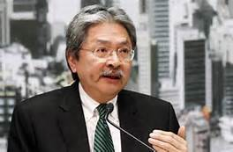
CEPA新協議 助港參與「一帶一路」
財司：新里程碑 港銀開業年限要求撤銷
內地和香港昨簽署新一份CEPA（內地與香港關於建立更緊密經貿關係的安排）協議，將大部分在廣東先行先試的開放措施，推展至全國實施。
(HK Economic Times, 28 November, 2015)

Slide 20
Answer the following questions:
What did the main text of the CEPA agreement set out?
What is the benefit of the “Most-favoured Treatment” provision of the Agreement?
What basically will the Agreement achieve?
Notes:
Teacher distributes the article:“ New Agreement signed under framework of CEPA to basically achieve liberalisation of trade in services between the Mainland and Hong Kong” (Trade and Industry Department, 27 November, 2015).
Students can work in groups or work at home to complete Worksheet 4.

Slide 21
What did the main text of the CEPA agreement set out?
Answer:
The main text of the Agreement sets out provision for, among others, national treatment, most-favoured treatment, safeguard measures, exceptions, and investment facilitation.

Slide 22
2. What is the benefit of the “Most-Favoured Treatment” provision of the Agreement?
Answer:
Hong Kong will be in a favourable position to enjoy the most preferential liberalisation measures of the Mainland.

Slide 23
3. What basically will the Agreement achieve?
Answer:
The Agreement will basically achieve liberalisation of trade in services between the Mainland and Hong Kong, enabling both sides to reach a new milestone after the continuous liberalisation of trade in services through CEPA over the years.
Notes:
[Additional Information for reference]
The Agreement has liberalisation in a number of important sectors which further enhances the liberalisation measures and geographical coverage to the whole Mainland. National treatment will be applied to Hong Kong in 62 sectors now.
Restrictive measures are reduced in the positive lists for cross-border services as well as cultural and telecommunication services. Service sectors under further liberalisation also include legal, accounting, insurance, securities, banking, transport, audiovisual, etc.

