Slide 1
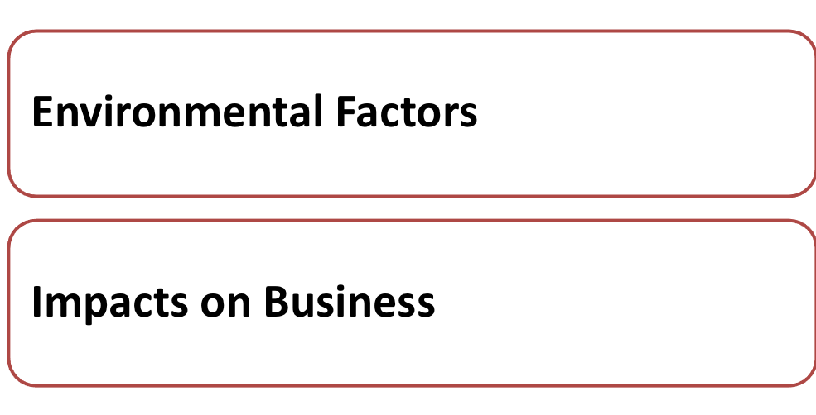
Lesson 3

Slide 2
Source: Yahoo pictures
Notes:
Teacher can use an example of running a small grocery, boutique or stationery shop to introduce to students that business operation is affected by many external environmental factors.

Slide 3
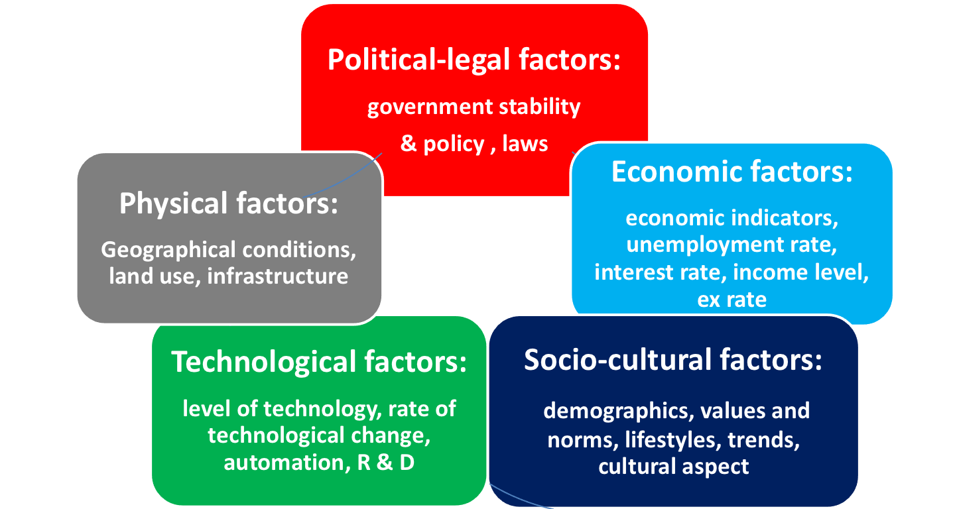
In the business world, there are many factors bringing unexpected changes and challenges to business.
Managers have to consider these factors as they may affect business decisions. These factors are:
Notes:
Teacher explains to students the five environmental factors affecting business decisions.

Slide 4
Health consciousness
Competition law
Consumer price index
Receptive to Korean culture
Robotic operation
Aging population
Increase in interest rate
The Third Runway Project
Notes:
Teacher asks students to classify the factors provided in Worksheet (5) to check their understanding of different environment factors.

Slide 5
Class Activity (5) –
Classification of environmental factors
Health consciousness – Socio-cultural factor
Competition law – Legal factor
Consumer price index – Economic factor
Receptive to Korean culture – Socio-cultural factor
Robotic operation – Technological factor
Ageing population – Socio-cultural factor
Increase in interest rate – Economic factor
The Third Runway Project – Physical factor
Notes:
Teacher checks and explains the answers with students.
Health consciousness – a kind of social values and thinking that affect daily life and purchasing habit →Socio-cultural factor
Competition law – the new regulation may affect business practices, in particular, price setting → Legal factor
Consumer price index – the index indicates the general price level of products that may affect the pricing of products → Economic factor
Receptive to Korean culture – our society has a favourable attitudes towards some countries’ culture such as Japan and Korea →Socio-cultural factor
Robotic operation – some companies have adopted automation and even use robots in operations → Technological factor
Ageing population – this relates to the demographic composition, more aged people in the society that may affect the composition of workforce and product types → Socio-cultural factor
Increase in interest rate –interest rate affects the cost of borrowings for doing business and affects people’s intention to spend → Economic factor
The Third Runway Project – it affects the transportation cost and efficiency → Physical factor

Slide 6
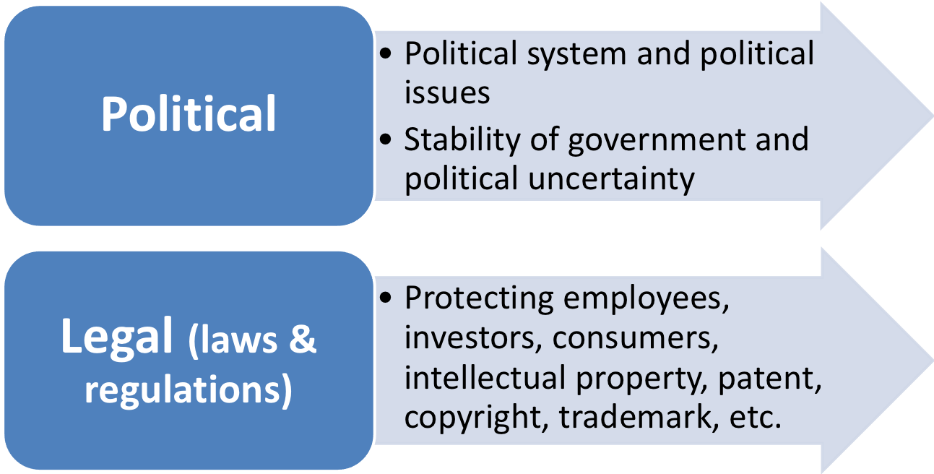
Notes:
Teacher explains further the environmental factors with real-life examples.
Political and legal environment involves political stability and political climate of a particular country or region, political system, government policies/activities and legislation on many areas.
For example, HK has a relatively stable political condition which implies low political risk. Hence, foreign companies are willing to set up offices here.
For the legal aspect, there is Employment Ordinance and relevant labour legislation to protect employees; Trade Descriptions Ordinance and others to protect consumers; Protection of Investor Ordinance and others to protect investors, Copyright Ordinance and others to protect intellectual property rights, etc.

Slide 7
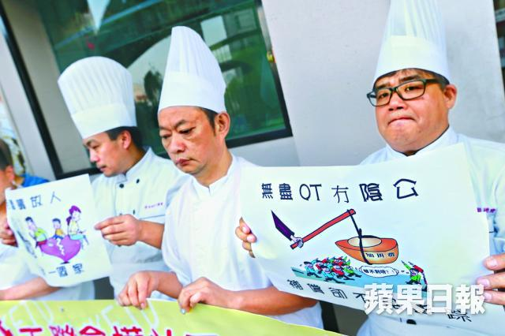
Copyright Ordinance
Prevention of Copyright Piracy Ordinance
Trade Mark Ordinance
競爭法生效初期着重教育
(Economic Journal, 8 December, 2015)
《競爭條例》下周一（14日）正式生效，外界關注競爭事務委員會如何應付日後工作。商務及經濟發展局局長蘇錦樑昨天到灣仔的競委會辦公室了解運作情況。他表示，法例實施初期，會着重教育方面工作，相信競爭法實施後，市民會有更多選擇，對經濟持續發展亦有幫助。
倘立法, 整體行業需增聘30萬人。一 群廚師到會議場外持標語示威，爭取標時立法。
(Apple Daily, 28 November, 2015)
Notes:
If the standard working hours regulation is to be enforced, companies may need to employ more workers and the labour cost is also likely to increase.
Companies need to be aware of the infringement of others’ intellectual property, trade mark and original work or design.
With the enforcement of competition law on 14 December 2015, companies’ pricing practices may be affected and they need to observe:
The First Conduct Rule prohibits anti-competitive agreements;
The Second Conduct Rule prohibits abuse of market power; and
The Merger Rule prohibits anti-competitive mergers and acquisitions.

Slide 8
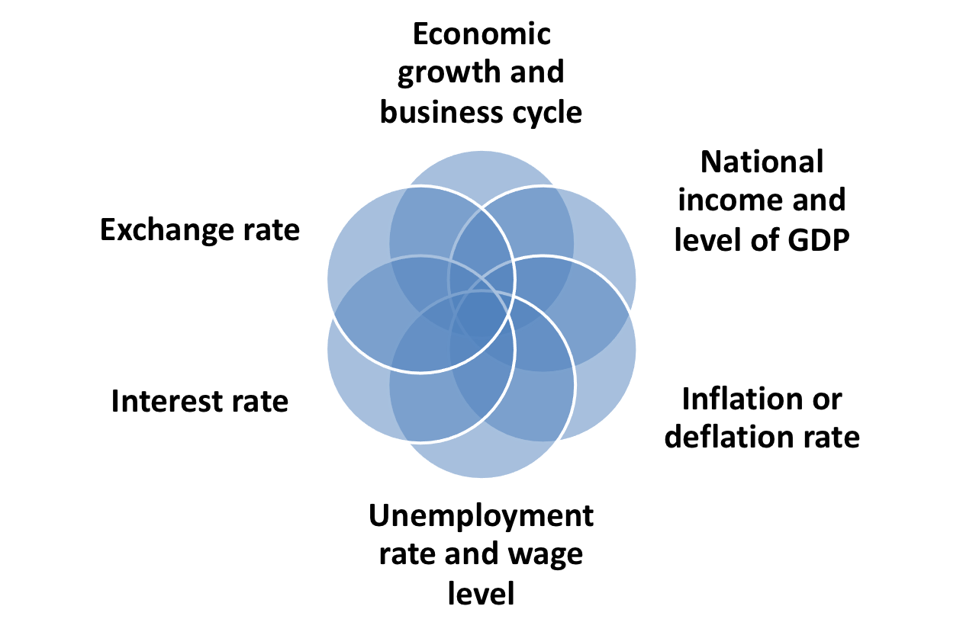
Economic Factor
Notes:
The general state of the economy can significantly affect the success or failure of a business.
Economic growth and business cycle – slow down of economic growth will hurt people’s consumption power; booming and recession are two different economic conditions
National income and level of GDP – high level of income and GDP means high consumption power and high potential to earn more income
Inflation or deflation rate – the rise or drop in general price level; such rates will affect people’s purchasing power
Unemployment rate and wage level – high unemployment rate may indicate less booming or stagnant economy; the level of wage increase will affect people’s consumption power
Interest rate – monetary policy and money supply of an economy will affect interest rate and the level of interest rate will affect cost of borrowing or cost of investment
Exchange rate – HK is an open economy and HK is adopted a linked exchange rate system in which HK dollars are pegged to US$, strong or weak US$ will affect the relative cost of products or services both at home and overseas

Slide 9
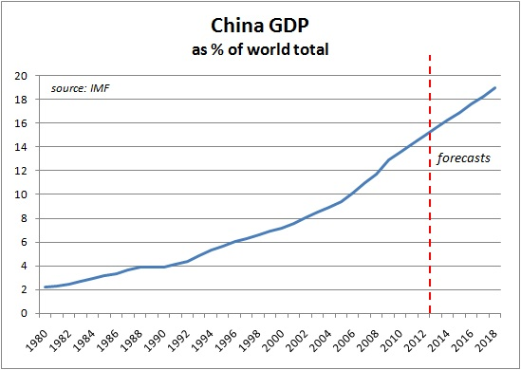
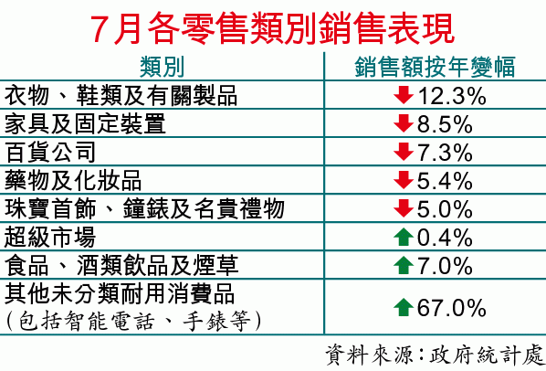

Slide 10
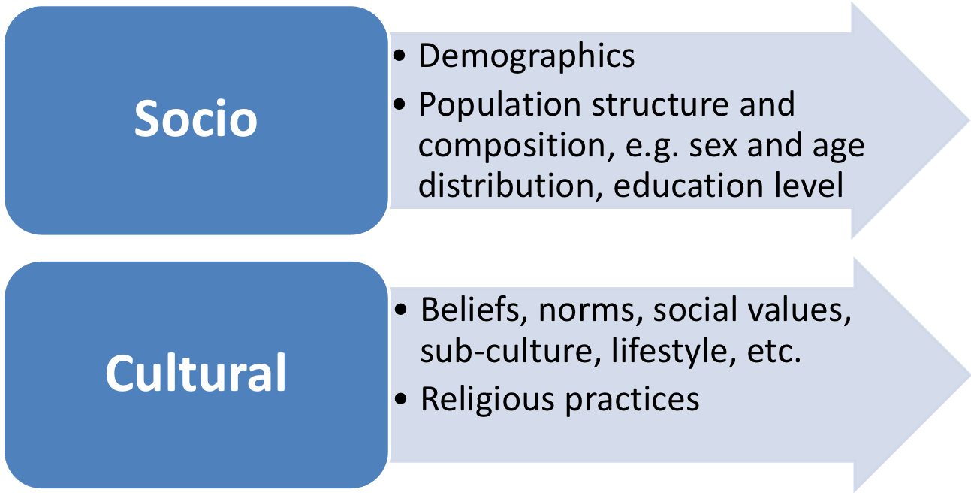
Socio-cultural Factor
Notes:
Socio-cultural factor cover broadly the demographics, population trend, gender, race, etc. Demographics help businesses define the markets for their products and also help determine the market size and composition of workforce (e.g. Generation X and Y, male vs female).
Social change is another challenging environmental factor. People’s attitudes, values and lifestyle shape the social environment. Nowadays, people prefer more freedom at work, better work-life balance, job challenge and satisfaction. HK people’s values include materialism, convenience, justice, etc. All these will affect people’s consumption pattern, preference, spending priority, etc.

Slide 11
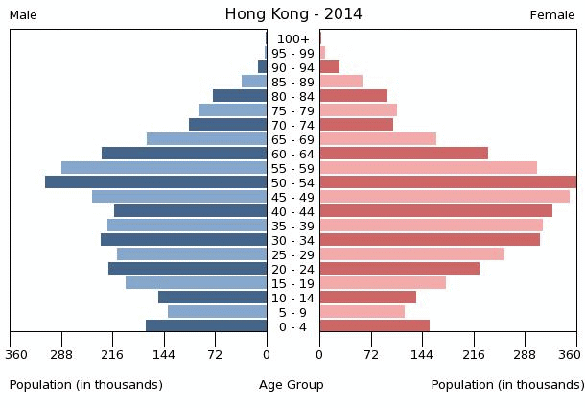
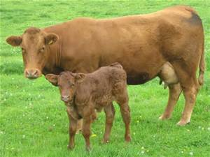
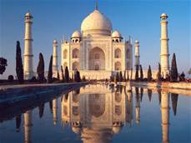
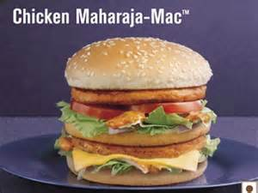
Hindu – Scared animal
A different “hamburger” in India
Notes:
Socio-cultural factors usually are the invisible barriers to business success, especially in overseas market where national culture is a challenge issue to tackle.
E.g. The United States-based consumer electronics retailer Best Buy failed in the Mainland because they neglected the culture and buying habits that Chinese like to bargain when buying products. Best Buy just offered a standard price and coupled with other market factors, it finally decided to withdraw from the Chinese market.
E.g. KFC has been adopting customisation in entering the Mainland market. Many localised products like chicken roll of Old Beijing, herbal tea, Chinese pancake, congee, mushroom spring roll, etc. are offered to suit the local people’s tastes.

Slide 12
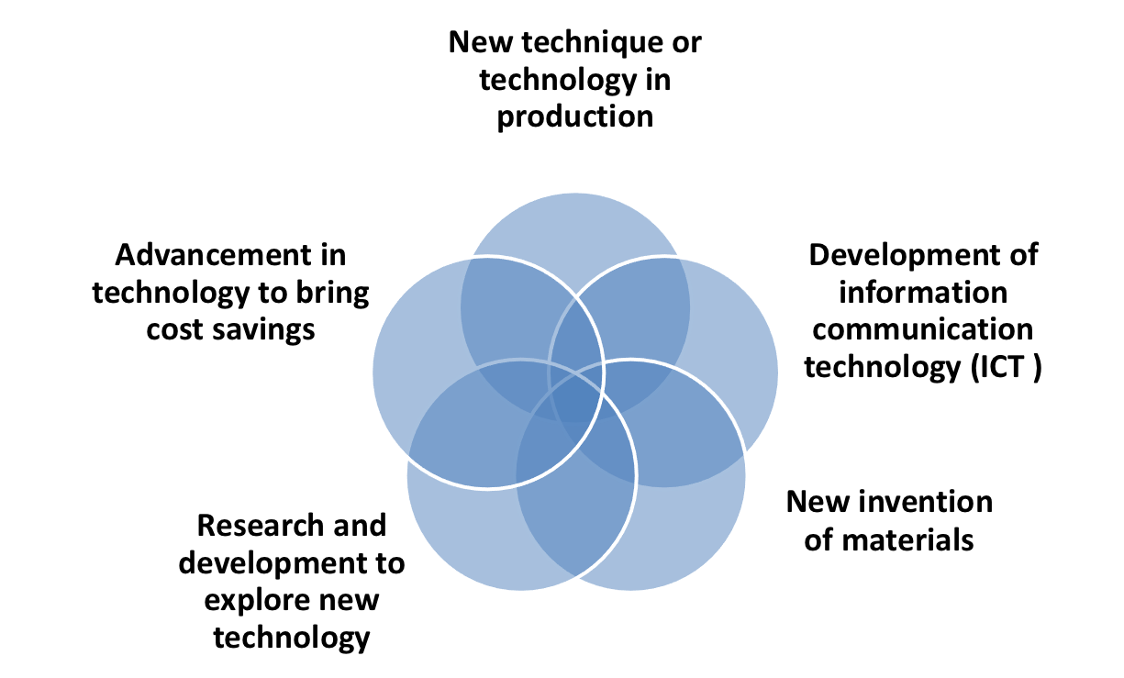
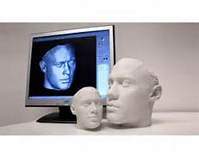
Technological Factor
Notes:
Technological factor has a great impact on business operation. The application of technology can stimulate economic growth and improve quality of product/service. New machines will improve productivity and reduce costs (e.g. 3D printing and automated dish-washing machines). New materials may help conserve environment (e.g. polysilicon raw materials for solar energy system and bio-degradable materials for consumer products ) and new invention can better serve consumers’ need (e.g. mobile apps and electric cars). Also, with the help of advanced ICT, information flow and communication quality can be enhanced.

Slide 13
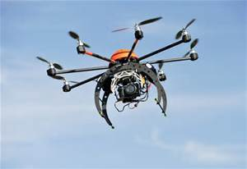
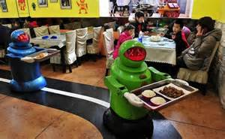
網購風氣盛行 Visa大打方便牌
綫上購物已成潮流，據Visa電子商務消費者報告顯示，近9成香港消費者都曾進行網上購物，網上消費額更按年大增三分一之多，其中更有3成多用家會以智能電話完成交易。於是幫助消費者更快捷、更安全地完成交易，就成為不同支付工具的重要任務。
(HK Economic Times 30 November, 2015)
Aerial photography
IT advancement facilitates Internet shopping
Robotic operation
Notes:
Business may need to be aware of the technological development and explore opportunities to apply new technology in saving operation costs, designing new products or services, improving productivity and quality, etc. Hence, business may need to spend more on research and development.

Slide 14
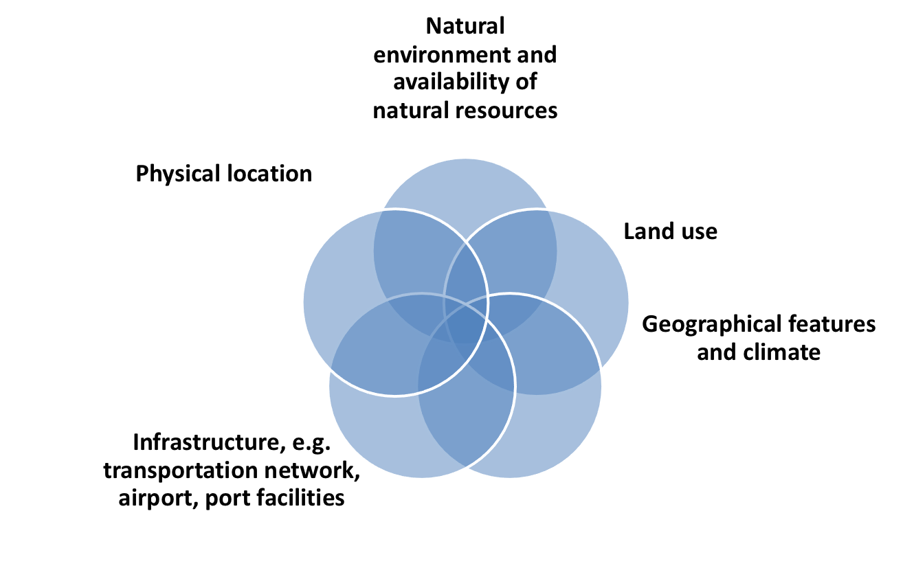
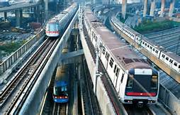
Physical Factor
Notes:
It mainly refers to the natural environment – use of land and natural resources, and sometimes the depletion of raw materials.
It also relates to the geographical and climatic conditions of a country or region. Environmental pollution and infrastructure (e.g. port and airport facilities) are also included.
Business has to take into consideration the physical factors and different weather conditions when they select plant site, transportation mode, communication means, product or service offerings, etc.

Slide 15
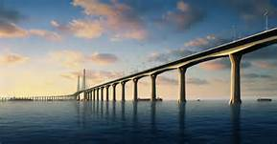
Extension of MTR,
The Third Runway project,
High speed train
HK-Zhuhai-Macau Bridge
Upgrading of communication facilities
Notes:
Teachers can check students’ awareness of these infrastructure projects.
Physical factors will affect the efficiency of business operation. The delivery of materials and finished products relies on good transportation system and the flow of information also relies on good communication network.

Slide 16
Overall consumption of the economy and the purchasing power of customers
Operation/investment costs
Spending habit, behavior and preference
Efficiency in getting business information and transporting products/materials
Application of technology in business operation
Level of political risk and market risk
Notes:
Overall consumption of the economy and the purchasing power of customers – economic factor: economic situation goes worse
Operation/investment costs – economic factor: inflation and interest rate
Spending habit, behavior and preference – social factor: people values change
Efficiency in getting business information and transporting products/materials – physical factor
Application of technology in business operation – technological factor
Level of political risk and market risk – political factor: if political situation becomes unstable and uncertainly, the level of political risk is higher; social factor: if consumers’ taste and preference change drastically, market risk will be higher

Slide 17
What are the challenges of setting up a small café under today’s business environment?
Notes:
Students are divided into groups of 4 to complete Worksheet (6).

Slide 18
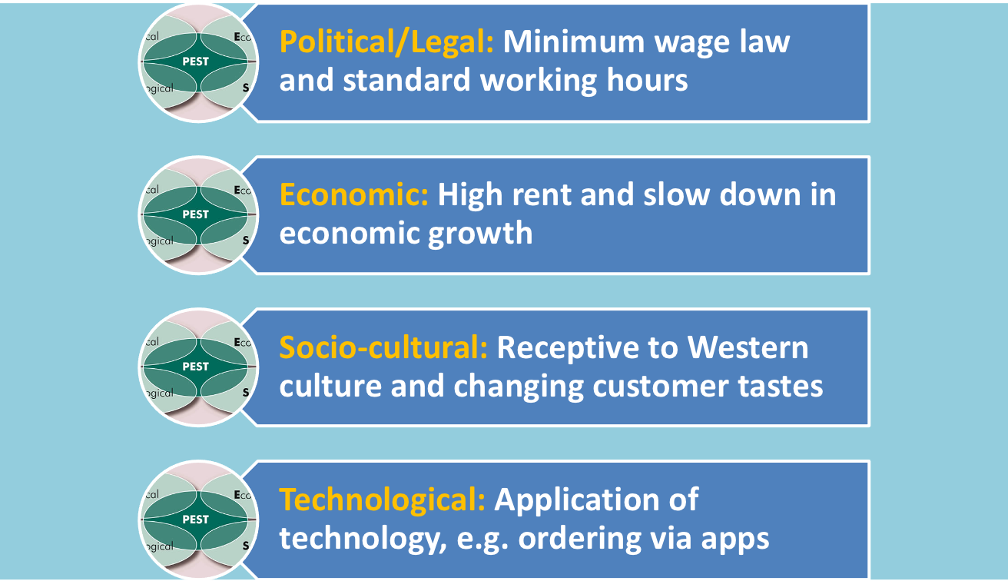
Challenges
Notes:
Teacher can encourage students to think of as many challenges as possible, and then give feedback on their sharing of views.

