Slide 1
Lesson 4
Globalization
Impact on Hong Kong Business
Ways for Going Global
Reasons for Going Global

Slide 2
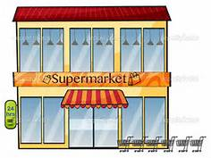
Class Activity (7)
Imagine you were in a supermarket and going to buy five items of goods. State how and where they were produced.
Notes:
Students will likely pick some snacks like chocolate bars, potato chips, cup noodles, coffee, etc.
Teacher can guide students to think about the production process of these products -- where the raw materials (cocoa bean and coffee bean in South America, plant potatoes in the US, plastic making in the Mainland, etc.) came from, how they were transported to the production sites, how they were marketed all over the world. For example, some large companies like M & M, Kraft, Pringles, Nissan, market their products worldwide but these products may be produced in some low cost regions like Mexico, the Mainland and some other South-east Asia countries. These business activities demonstrate the concept of globalization and the globalization of world commerce has an impact on people.

Slide 3
Globalization
The increasing integration and interdependence of national economies around the world.
Including all business activities that involve exchanges across national boundaries.
Why companies go international and global
Notes:
Globalization can be viewed as an integrated process that cover many aspects such as economic, cultural, social, technological and political.
As the Class Activity (7) demonstrated, usually standardised products are designed in one country, manufacturing and assembled in other countries, and finally sold globally. People of the world are “unified” into a single society or a “global village”.

Slide 4
Reasons for Going Global
Grasp global market opportunities
Obtain materials/goods/labour at lower costs
Enjoy economies of scale
Develop global brands and create global connection
Avoid trade barriers or restrictions
Favourable government treatment
Notes:
Grasp global market opportunities – increase sales and profit; provide outsourcing possibilities; diversity business areas and markets
Obtain materials/goods/labour at lower costs – some countries have unique and rare resources (e.g. iron and steel mines) or such resources are bulky to transport; some countries can provide cheap labour; the mobility of resources are higher that facilitates global sourcing
Enjoy economies of scale – increase the scale of production can lower the average cost
Develop global brands and create global connection – develop and access strategic markets and international collaboration, and enlarge global market share
Avoid trade barriers or restrictions – setting up factories or operation overseas can avoid barriers or restrictions such as import quota and tariffs, and have better control over direct investment overseas
Favourable government treatment – some less developed countries may offer tax incentive and preferential tax rate to foreign firms in order to encourage foreign firms to invest in their countries

Slide 5
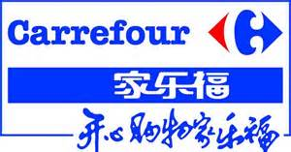
Globalization
Multi-national Corporation (MNC)
The buying, selling and trading of goods and services across national boundaries.
Operates on a worldwide scale without significant ties to a single nation or region.
Visit MNCs such as CK Hutchison Holdings Ltd. and find the firm’s global footprint!
Notes:
Many large companies actually is operating in a borderless world. The multi-national corporation (MNC) is a business with facilities in many countries other than its own that operate on a global basis by making management decision regarding profits, facilities, sales and services in many parts of the world. MNCs often adopt the approach of “think global, act local”. They have to cope with very different environments, stages of economic development, legal, and taxation systems, and often bear higher political risks. They also have to cope with a variety of time zones and geographic distances, manage a work force of many different nationalities and cultures.
Students can visit CK Hutchison Holdings Ltd to find the firm’s global footprint http://www.ckh.com.hk/en/businesses/global.php

Slide 6
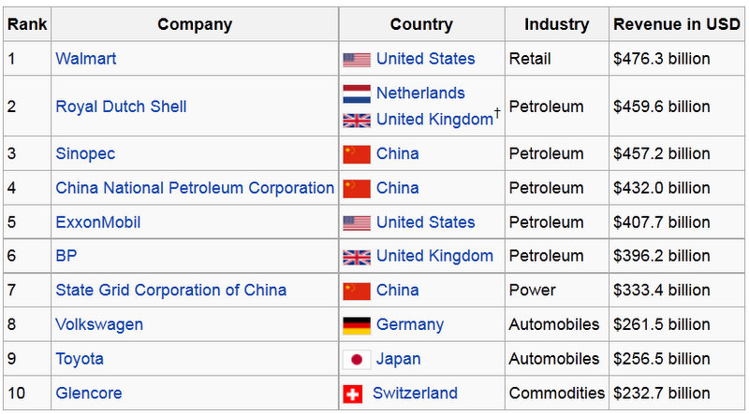
Globalization – World's 10 Largest Companies
Source: Global Fortune 2014

Slide 7
Ways for Business to Go Global
1. Licensing
e.g. Sanrio grants licenses of brands to business firms all over the world – USA, Canada, Latin America, Europe and Asia.
Source :
Sanrio website and yahoo pictures
Notes:
Companies can use licensing to get into an international market quickly while taking relatively risks.
Sanrio (licensor) allows foreign firms (licensees) to sell its products or use its intellectual property (e.g. copyright, patent, trademark) by granting them rights and charging them royalties.

Slide 8
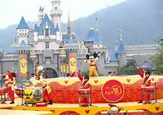
Ways for Business to Go Global
2. Joint Venture
e.g. Hong Kong Disneyland Resort is owned by a joint venture company, Hongkong International Theme Parks Limited, with shareholders, the Hong Kong Government and The Walt Disney Company
e.g. Hong Kong Maxim's Group Formed joint venture with Starbucks Coffee International, Inc in 2000.
Notes:
Forming a joint venture is a common way for companies to enter international markets.
By an equity agreement with a local company, they can produce and/or market their products in other countries.
Risk, capital, expertise can be shared between/among “partners”.
Additional example:
The German automaker BMW said Wednesday that it would significantly expand its operations in the fast-growing Chinese market, doubling the number of models it produces there and extending its alliance with a local partner …… Source: The New York Times 16, July, 2014
BMW formed a joint venture with Brilliance China Automotive Holdings Ltd. (華晨中國汽車集團控股有限公司) and called” “BMW Brilliance Automotive Ltd” (華晨寶馬汽車有限公司).

Slide 9
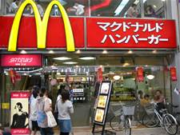
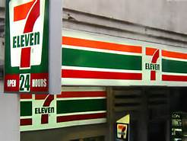
Ways for Business to Go Global
3. Franchising
7-Eleven in the US used franchising to expand business globally.
“When you franchise with 7‑Eleven, you become part of a brand that’s known and loved around the world.”
McDonald’s franchises restaurants in many international markets.
Notes:
Similar to licensing, franchising is another popular way to expand business overseas .
MNCs (franchisors) grant to other foreign companies (franchisees) the right to market their products in their countries under MNCs’ brand name and specified standards.
The franchisee is responsible for all operations with franchisor’s support and established business model/operation mode.
Same as licensing , franchisors will receive royalty and some other fees from franchisees.
Some Hong Kong business such as jewellery chain store recruit franchisees in the Mainland to expand their business.

Slide 10
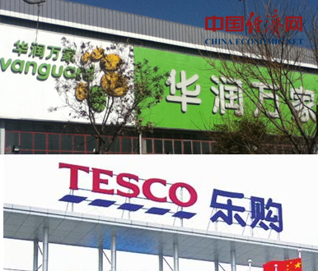
Ways for Business to Go Global
4. Strategic Alliance
E.g. China Resources Enterprise and Tesco joint hands for retail breakthrough …
….. alliance between China Resources and Tesco has shocked the market, for both sides have their own intention: the former intends to increase its market shares, while the latter hopes to accelerate its localization process. Cooperation of the kind might frequently emerge in retailing field in the future.
Source: 23 October, 2013, China Economic Net
Notes:
Sometimes, companies may not involve equity arrangement and form a joint venture, instead, they will form a strategic alliance.
Strategic alliance is an agreement between companies to combine their capabilities and resources to accomplish global objectives and gain mutual benefits or synergy effect.

Slide 11
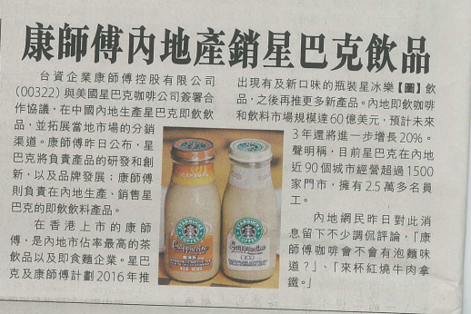
Ways for Business to Go Global
4. Strategic Alliance
E.g. Taiwan-based Master Kong signed collaboration agreement with Starbucks to sell drinks in China. market.

Slide 12
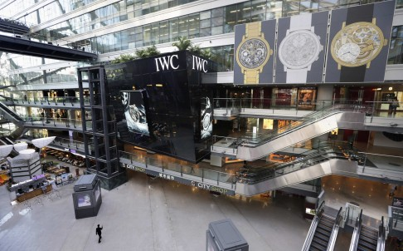
Ways for Business to Go Global
5. Foreign Direct Investment (FDI)
China attracted FDI of US$10.8 billion last month, up 16.1 % from a year earlier, the Ministry of Commerce said yesterday, boding well for the top leaders' efforts to keep the economy on an even keel as they push reforms.
China is still enjoying FDI inflows while other emerging markets are suffering capital flight. Photo: Reuters (SCMP, 18 February, 2014)
Notes:
As the market expands, some companies will decide to invest directly in other countries to gain better access to the market and gain competitive advantages.
Foreign Direct Investment (FDI) is the formal establishment of business operations on foreign countries. For example, building factories and plant sites, employing local people and setting up distribution network.
It involves higher cost and risk but with better control and greater potential return.

Slide 13
Ways for Business to Go Global
Can you list the advantages and disadvantages of the ways to go global?
Can you think of other examples
Notes:
Teacher can guide students to think of more examples.
Depending on students’ ability, teacher can give hints to students on the advantages and disadvantages of various ways to go global. Criteria include risk level, extent of control, profit potential, cost, flexibility, potential conflicts with joint venture partners, etc.

Slide 14
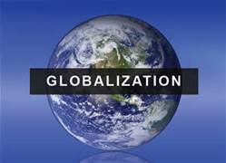
Class Activity (8) – Group Discussion
Discuss the impacts of globalization on Hong Kong business.
Notes:
Students are divided into groups of 4 and start discussion on the impacts of globalization on Hong Kong business and complete Worksheet 8.

Slide 15
Impacts on Hong Kong business
Business will become more integrated and interdependent with the world economy
More cooperation with companies in other countries that can play a complementary role to each other
Not only compete on the local market, but also foreign markets and foreign rivals
Face challenges on financial, tourism and logistics industries from countries and regions nearby
Notes:
Teacher invites each group to share their views and then wraps up. Suggested answers are provided for reference.
Business will become more integrated and interdependent with the world economy – greater influence from other countries, e.g. financial tsunami, able to obtain resources and talent from the global → global sourcing.
More cooperation with companies in other countries – establish global network and connection, form strategic alliance or joint venture with foreign companies.
Not only compete on the local market, but also foreign markets – HK companies can expand overseas and therefore they need to compete with companies overseas and vice versa.
Face challenges on financial, tourism and logistics industries from countries and regions nearby – competitiveness of nearby places and regions are keen, e.g Shenzhen and Singapore.

Slide 16
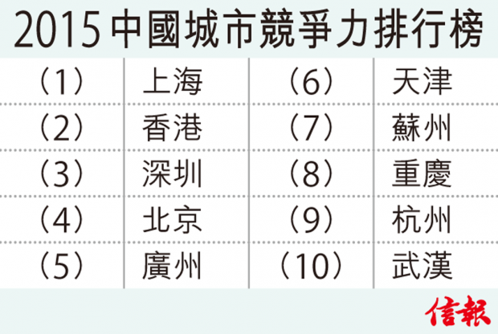
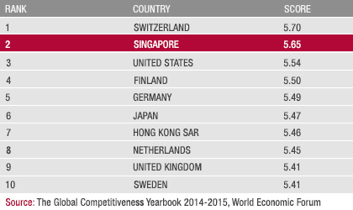
Impacts on Hong Kong business
10 December, 2015

Slide 17
END

