Slide 1
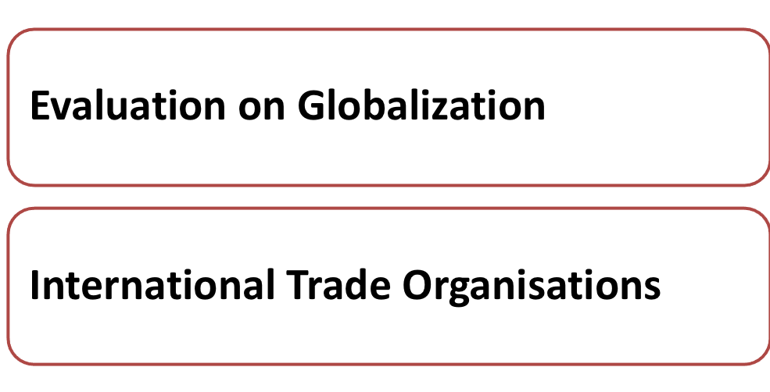
Lesson 5

Slide 2
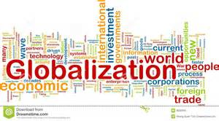
Concept of Globalization
Notes:
Teacher can check students’ understanding on globalization learnt last lesson.

Slide 3
Form groups to respond to the questions and case illustrations
Notes:
Teachers can ask students to form groups and hint them to think about the positive impacts of globalization and criticism against globalization. Forthcoming cases and questions might help give them some ideas before discussion.

Slide 4
Class Activity (9) – Part I Positive Impacts of Globalization
Can you find these two companies, (1) Giordano and (2) Watsons, in other countries?
Why are they setting up thousands of stores in different parts of the world?
Today, Giordano has successfully executed its multi-market and multi-brand strategy by operating over 2,400 stores in more than 30 countries.
Watsons is Asia’s leading health and beauty retailer, currently operating over 4,500 stores in 12 Asian and European markets, including China (Mainland China, Hong Kong, Taiwan and Macau), Singapore, Thailand, Malaysia, the Philippines, Korea, Indonesia, Turkey and Ukraine.
Find their global footprints!
Notes:
The Giordano Group launched a lot of brands in other countries. In 2013, it won the Emerging Market Retail Award and Giordano Middle East was ranked 19th by Forbes Magazine as "Top 100 Making an Impact in the Arab World”. Giordano entered other countries mainly via franchising.
Watsons continually sets the highest standards in the health, wellness and beauty market, providing personalised advice and counseling in health, beauty and personal care on top of its market-leading product range. Since 2009, Watsons has been the No. 1 Pharmacy/ Drugstore brand in Asia*. In Europe, Watsons is also the leading Health & Beauty retailer in Ukraine.
Positive Impacts:
More business opportunities to access world wide markets – globalization means more free trade between countries and different overseas markets can be developed by various modes, trade among countries becomes borderless and companies can reach different markets worldwide quickly.

Slide 5
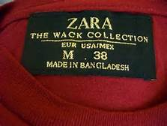
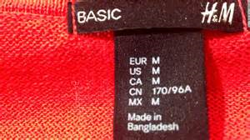
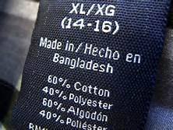
Class Activity (9) – Part I Positive Impacts of Globalization
Why do H&M and Zara employ workers in Bangladesh to make clothing for them?
Notes:
In order to save production cost, H&M outsources its production process to some low-cost countries such as Bangladesh.
Additional example: Li & Fung sources great products from suppliers around the world. The company evaluates factories based on their capability to supply the right product and based on their commitment to quality, safety and compliance. Li & Fung works with over 15,000 suppliers in multiple ways to meet our customers’ needs.
Positive Impacts:
Allow global sourcing of materials and talent – low-cost workforce and expertise, goods and raw materials, can easily be obtained from other countries with more efficient global transportation facilities .

Slide 6
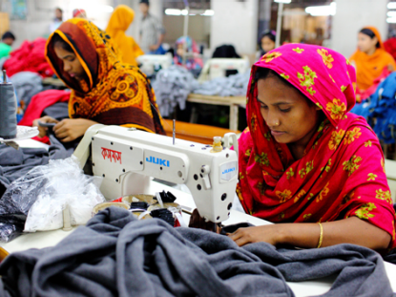
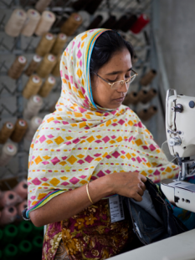
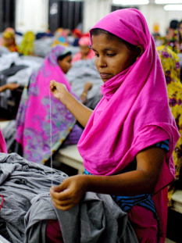
Many of our products are made in some of the world’s poorest countries …. the clothing industry creates millions of jobs, so it’s often the first step to greater prosperity for developing countries. Bangladesh is one of our most important production markets. Find out what we are doing to support the country’s development, and improve the lives of people living there.
Notes:
Positive Impacts:
Create employment opportunities – large international companies create wealth and foreign currency to less-developed economies when they buy local resources, products and services., and transfer knowledge and technology. The extra money created by this investment can be spent on education, health and infrastructure of those host countries.

Slide 7
Class Activity (9) – Part I Positive Impacts of Globalization
What are the impacts of globalization on information and capital flow?
The internet and mobile technology has allowed greater communication between people in different countries.
International financial institutions also facilitate speedy flow of capital.
Notes:
Positive Impacts:
Freer flow of capital and information – globalization facilitates flow of capital because of integration and interdependent financial markets; free and fast flow of information because of advancement of IT and other communication technologies
All the positive impacts of globalization promote better integration of the world –resources, knowledge, invention, goods and services can be shared and enjoyed by different parts of the world, less developed countries can benefit from investment by developed countries

Slide 8
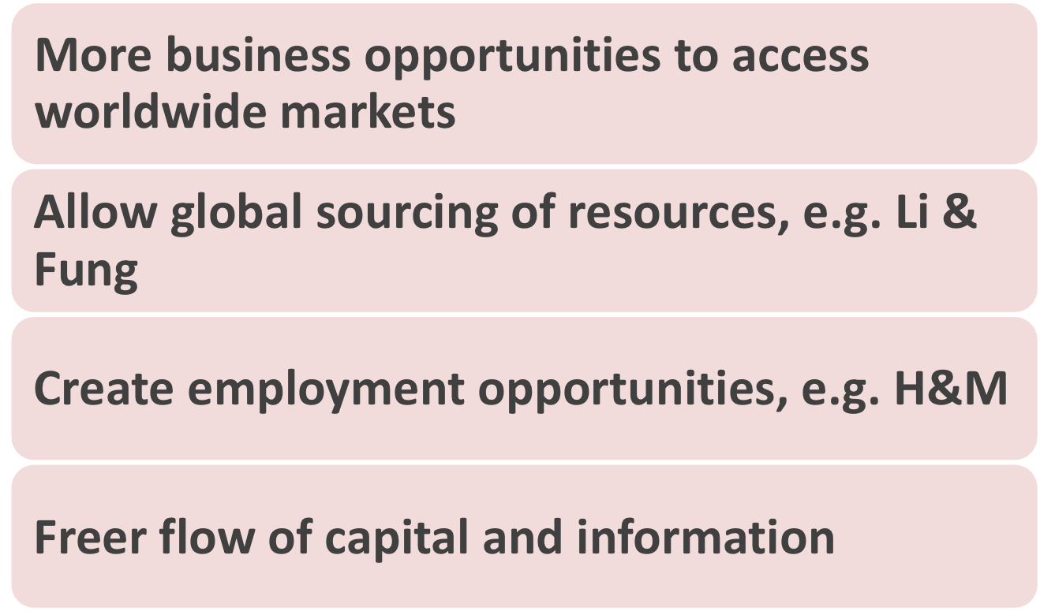
Notes:
Based on the cases illustrated, each group should sum up the positive impacts of globalization and complete Part I of Worksheet 9.
Teacher then explains the summary of points and concludes that all the positive impacts of globalization promote better integration of the world – resources, knowledge, invention, goods and services can be shared and enjoyed by different parts of the world, less developed countries can benefit from investment by developed countries

Slide 9
How about criticism?
Notes:
Teacher can hint students to think about the criticisms against globalization by the forthcoming questions and case illustrations.

Slide 10
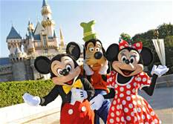
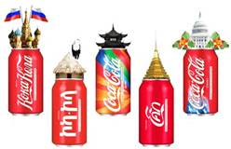
Class Activity (9) – Part II Criticisms again Globalization
What are the common products offered by McDonald’s, Disneyland and Coca Cola?
Notes:
Students should be able to list the common products offered by these global companies. Expected answers include hamburgers, French fries, Mickey Mouse, Buzz Lightyear and Coca Cola, etc.
Criticism:
Invasion of local culture – some MNCs sell one particular standardised products to all over the world, local culture may be replaced by global culture, local culture may be “diluted” and not be respected

Slide 11
Class Activity (9) – Part II Criticisms again Globalization
Why are there fair trade coffee beans in Starbucks?
Notes:
In order to stop the exploitation of farmers and foreign dominance in the marketing of agricultural products, the World Fair Trade Organisation sets some principles to protect the poor and disadvantaged farmers in developing countries (e.g. South Africa and countries in South America) and ensures farmers have a fair share of benefits from global trade. In the case of Starbucks, it refers to coffee beans farmers.
Criticism:
Increased poverty: larger income gap between rich and poor – globalization, coupled with capitalism (main enabler of globalization), has been associated with rising inequality and exploitation, and that the poor do not always share the gains from trade, appropriate policies may be needed to benefit the poor from globalization.

Slide 12
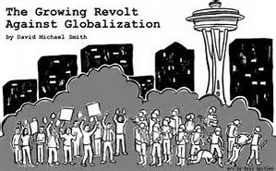
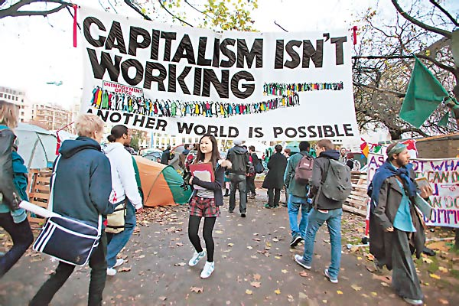
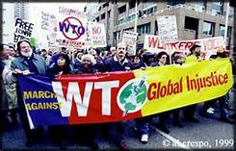
Class Activity (9) – Part II Criticisms again Globalization
Why are there protests against capitalism?
Yahoo pictures
Notes:
Additional example: People protested against capitalism – an “enabler” of globalization, which increase the wealth gap and bring about poverty problem.

Slide 13
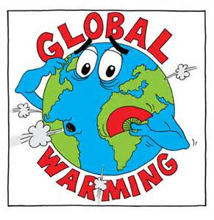
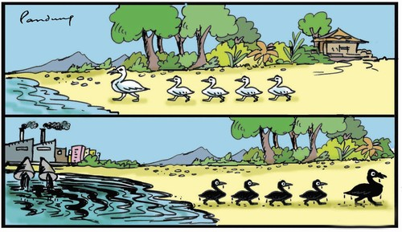
Class Activity (9) – Part II Criticisms again Globalization
Why do the following situations happen?
Notes:
Globalization that results in frequent economic activities among countries will pollute the global environment, deplete the natural resources and worsen the global warming problem.
Criticism:
Contamination of environment and depletion of resources – frequent economic activities as a result of globalization will bring different kinds of pollution such as air and water pollution to factories in the Mainland, resources may also be depleted due to business opportunities and overconsumption.

Slide 14
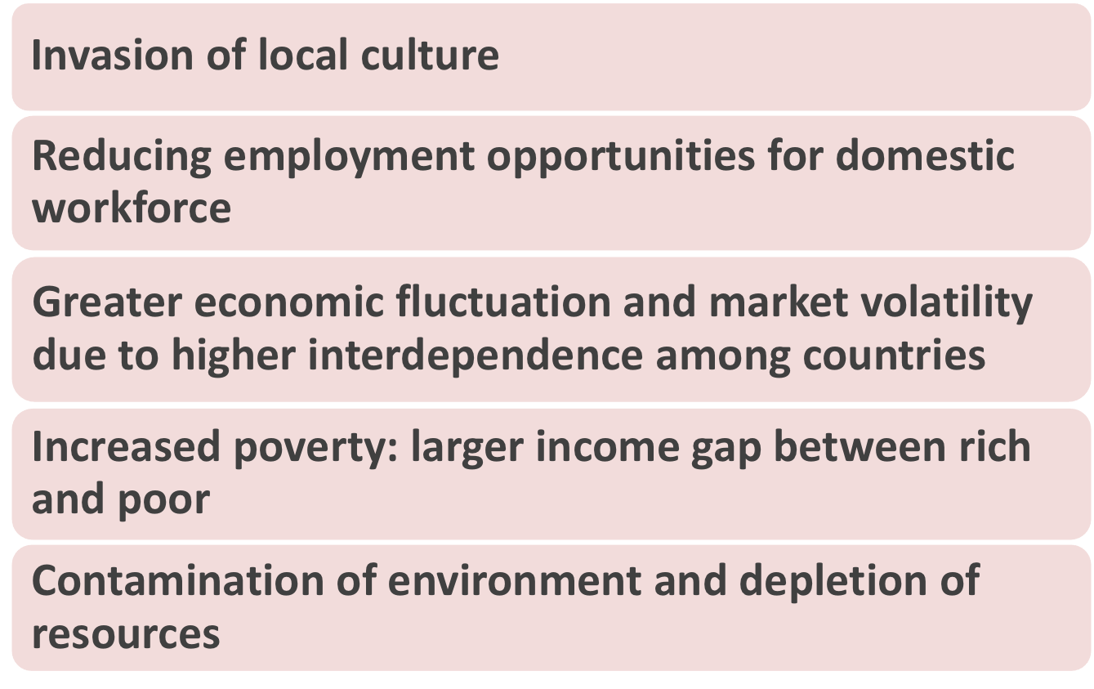
Notes:
Based on the cases illustrated and questions, each group should sum up the criticisms of globalization and complete Part II of Worksheet (9).
Teacher wraps up with highlight on the summary of note in PowerPoint.

Slide 15
With globalization and more frequent international trades, organisations that promote free and fair trade, establish trading rules and resolve disputes play an important role in global business world. Key international trade organisations include:
The World Trade Organisation (WTO)
Asia-Pacific Economic Cooperation (APEC)
International Monetary Fund (IMF)
Association of Southeast Asian Nations (ASEAN)
Notes:
The above are some major international trade organisations. Hong Kong has been participating actively in some of the above organisations, including WTO and APEC.
ASEAN, just like European Union (EU) and North American Free Trade Agreement (NAFTA), are trading blocs, or common markets, it is a regional organisation that promote trade among member nations.

Slide 16
World Trade Organisation (WTO)
provides a forum for negotiating agreements aimed at reducing obstacles to international trade and ensuring a level playing field for all, thus contributing to economic growth and development.
provides a legal and institutional framework for the implementation and monitoring of these agreements, as well as for settling disputes arising from their interpretation and application.
Notes:
WTO is the “successor” of GATT – General Agreement on Tariffs and Trade. As of 30 November, 2015, there were totally 162 members.
This organisation deals with the global rules of trade between nations. Its main function is to ensure that trade flows as smoothly, predictably and freely as possible. It is a rules-based, member-driven organization in which all decisions are made by the member governments, and the rules are the outcome of negotiations among members.
For details: https://www.wto.org/

Slide 17
Functions:
Administering WTO trade agreements
Forum for trade negotiations
Handling trade disputes
Monitoring national trade policies
Technical assistance and training for developing countries
Cooperation with other international organizations

Slide 18
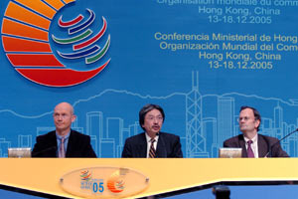
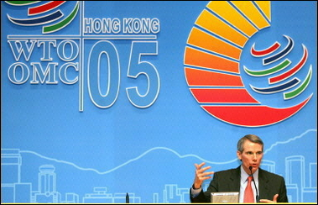
The Sixth Ministerial Conference of the World Trade Organisation was held at the Hong Kong Convention and Exhibition Centre, Wan Chai, Hong Kong from 13 to 18 December 2005. (Source: Yahoo pictures)

Slide 19
Asia-Pacific Economic Cooperation (APEC)
is the premier Asia-Pacific economic forum with a primary goal of supporting sustainable economic growth and prosperity in the Asia-Pacific region.
united to build a dynamic and harmonious Asia-Pacific community by championing free and open trade and investment
Notes:
APEC has 21 member economies (as at 20 January, 2016).
For details: http://www.apec.org/

Slide 20
Asia-Pacific Economic Cooperation (APEC)
promoting and accelerating regional economic integration, encouraging economic and technical cooperation, enhancing human security
facilitating a favorable and sustainable business environment.

Slide 21
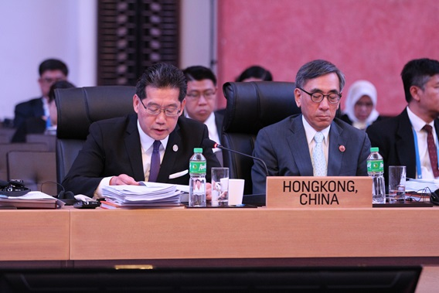
Asia-Pacific Economic Cooperation (APEC)
Secretary for Commerce and Economic Development, Gregory So Kam-leung, GBS, JP at 2015 APEC Ministerial Meeting, Manila, The Philippines 16-17 November 2015 (source: http://www.hk-apec.com.hk)

Slide 22
International Monetary Fund (IMF)
Functions:
foster global monetary cooperation
monitor global financial developments and secure financial stability
facilitate international trade, promote high employment and sustainable economic growth
Notes:
Created in 1945, the IMF is governed by and accountable to the 189 countries that make up its near-global membership.
The IMF’s primary purpose is to ensure the stability of the international monetary system -- the system of exchange rates and international payments that enables countries (and their citizens) to transact with each other.
Member countries work to foster global monetary cooperation, secure financial stability, facilitate international trade, promote high employment and sustainable economic growth, and reduce poverty around the world.
For details: http://www.imf.org/external/index.htm

Slide 23
International Monetary Fund (IMF)
Functions:
provide technical advice and training
provide short-term loans to countries that are unable to meet their financial obligations
alleviate poverty in developing economies

Slide 24
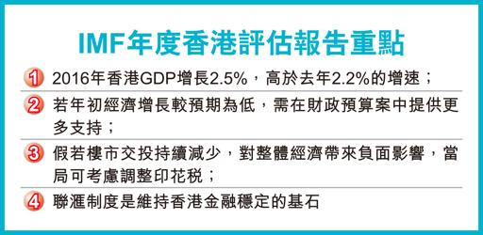
Source: 22 January, 2016, HK Economic Times

Slide 25
The Association of Southeast Asian Nations (ASEAN)
to accelerate the economic growth, social progress and cultural development in the region
to strengthen the foundation for a prosperous and peaceful community of Southeast Asian Nations
promote active collaboration and mutual assistance for raising of the living standards of their peoples
Notes:
The Association of Southeast Asian Nations, or ASEAN, was established in 1967 and currently there are ten Member States.
For details: http://www.asean.org/

Slide 26
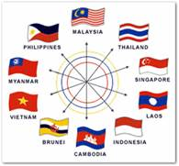
Key International Trade Organisations
The Association of Southeast Asian Nations (ASEAN)
東盟基建需求盛 港融資機遇大
共有6.25億人口的東盟10國區域在2015年的最後一天正式成立東盟共同體，…… 東盟經濟共同體謀求在2025年時已高度融合，同時增加行業間的合作，融入環球經濟。
港出口東盟升 逆市增長源頭
要達到以上目標，關鍵之一是完善東盟各國有助於人貨往來的相關基建 .…. 成為亞洲「和平的橋樑」。其實東盟基建的情況，不止是東盟的事，也與香港息息相關。從貿易出發，香港與東盟現正談判自由貿易協定，去年12月便完成了新一輪會議，而行政長官梁振英去年預計在今年內可以達成協議。
Source: Extract from HK Economic Times, 23 January, 2016
Notes:
The original news:
東盟基建需求盛 港融資機遇大
共有6.25億人口的東盟10國區域在2015年的最後一天正式成立東盟共同體，加強在政治和安全、經濟及社會文化3方面的連繫。當中，東盟經濟共同體謀求在2025年時已高度融合，同時增加行業間的合作，融入環球經濟。
港出口東盟升 逆市增長源頭
要達到以上目標，關鍵之一是完善東盟各國有助於人貨往來的相關基礎設施（下簡稱「基建」）。亞洲開發銀行研究所在2012年指出，亞洲地區發展基建的一個重要意義，就是釋放亞洲的經濟發展潛力，讓資訊更加流通，以及消除不同國家人民之間的收入差距，避免衝突，成為亞洲「和平的橋樑」。其實東盟基建的情況，不止是東盟的事，也與香港息息相關。從貿易出發，香港與東盟現正談判自由貿易協定，去年12月便完成了新一輪會議，而行政長官梁振英去年預計在今年內可以達成協議。

Slide 27
What are the primary functions of other international trade organisations? Find them out!
EU,
World Bank,
OECD ……
Notes:
Students are encouraged to search other similar international organisations and identify each of their primary roles and functions, then share their findings in the next lesson.

